Slide 1
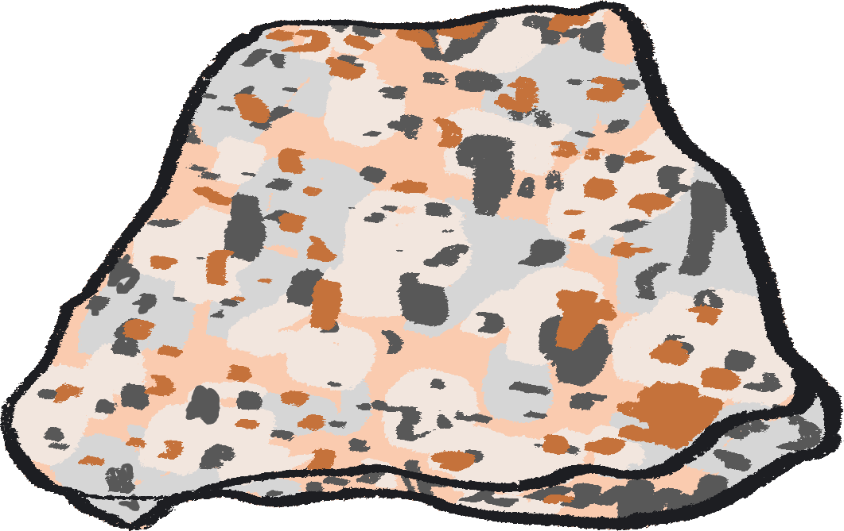
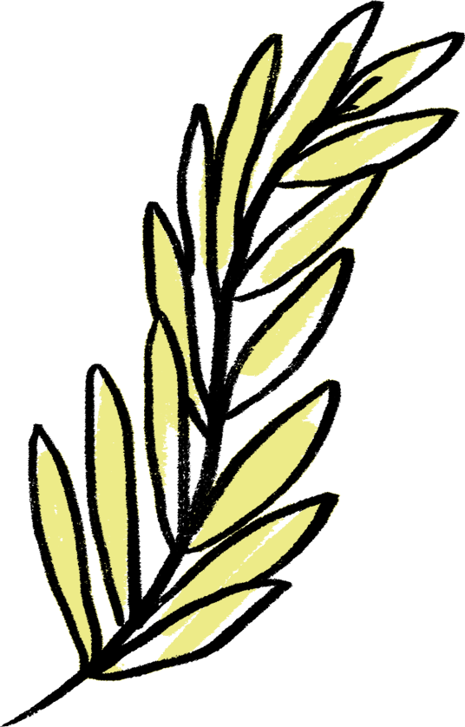
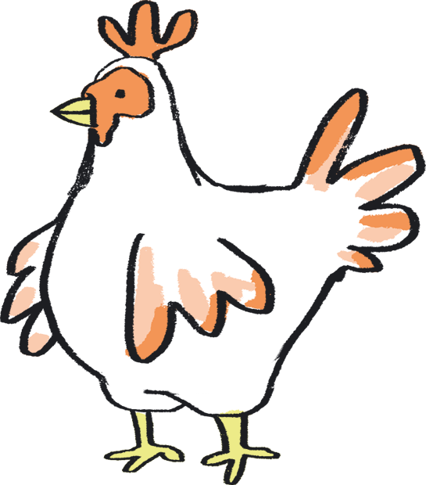
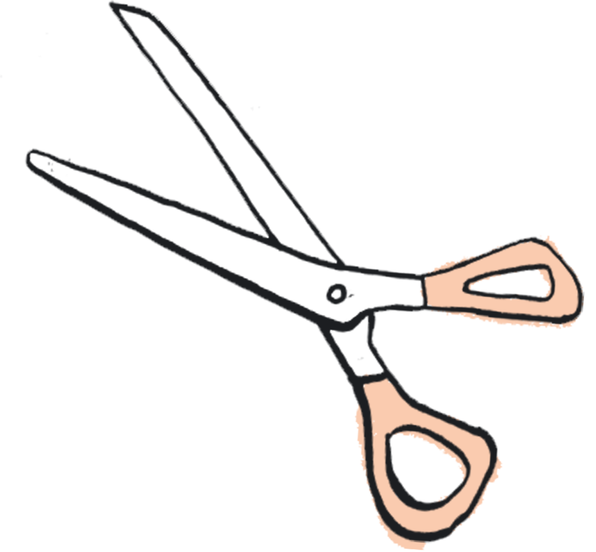
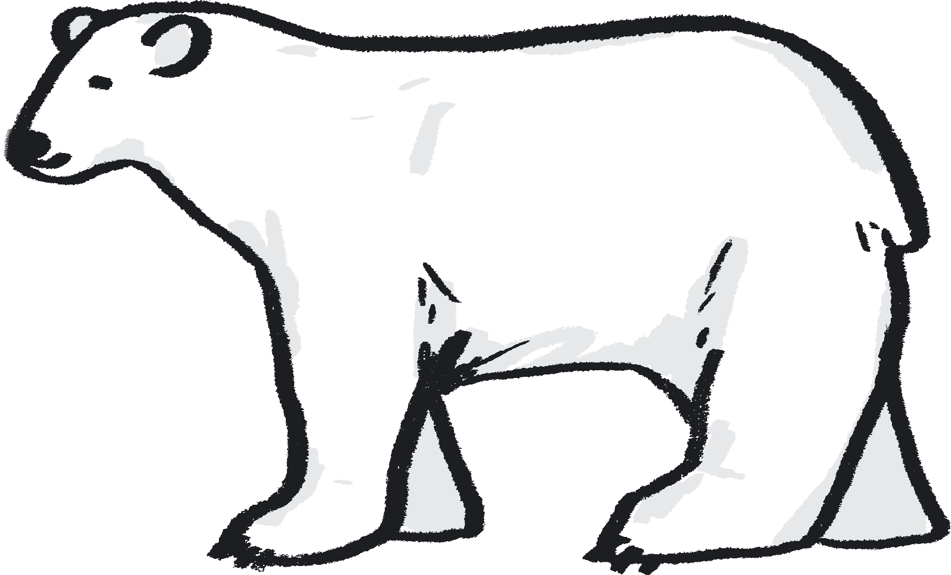
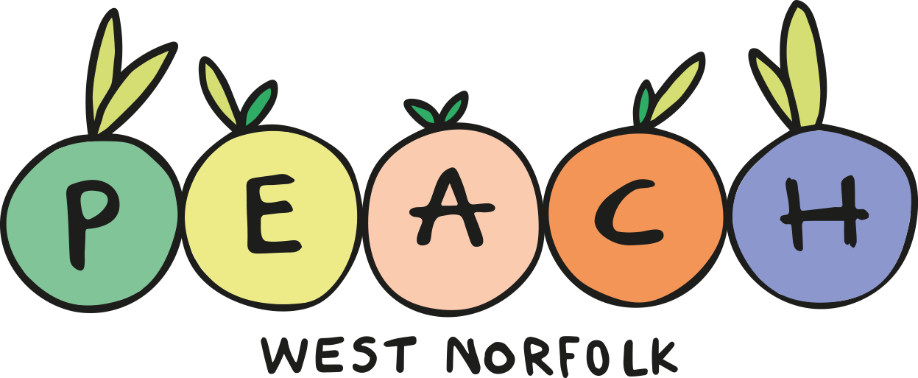
Teacher Lab
Teaching Resource – Slides and Notes

Slide 2
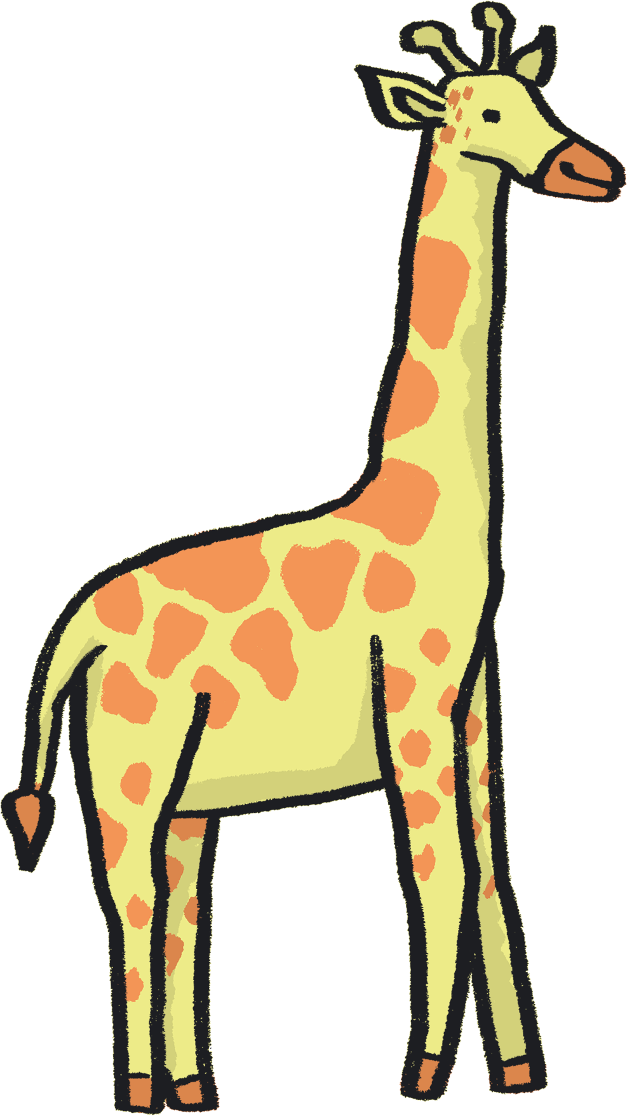
Contents
About Teacher Lab – slide 3
How to use this resource – slide 4
About this resource – slide 5
Author statements – slide 7
Lesson plans, slides 9 - 70
Reception – Sorting Natural Materials, slides 9 – 14
Year 1 – Leaves and Seasons, slides 15 – 23
Year 2 – Animal Habitats, slides 24 – 31
Year 3 – Rocks, slides 32 – 39
Year 4 – Teeth, slides 40 – 49
Year 5 – Life Cycles, slides 50 – 62
Year 6 – Evolution: Fossils, slides 63 - 70
Credits – slide 71
References – slide 73

Slide 3
About Teacher Lab
The Teacher Lab project promotes creative practice in the classroom by supporting cross-curricular teacher and artist exchanges in the UK. It offers teachers direct access to a variety of artists, in order to re-imagine the curriculum and develop practical tools for learning through the arts.
You can access the previous Teacher Lab resource (exploring Push and Pull forces) created by teacher Christina Paul and actor and mathematician Victoria Gould, here: https://sites.barbican.org.uk/teacherslab/
……………………………………………………………………………………………………………………………………………………………………………..
This Teacher Lab was a collaboration between Barbican Creative Learning, Creative Arts East for PEACH West Norfolk, and involved teachers Gill Sekatawa and Sarah Melia from Nelson Academy in Downham Market, Norfolk, and Norwich based artist Kaitlin Ferguson.
Through a series of planning, testing and reflection sessions, Gill, Sarah and Kaitlin co-designed a range of creative activities to support the delivery of the primary science curriculum. These were then developed into a resource pack, in the form of a set of PowerPoint Slides which can be used directly in a lesson, with supportive guidance notes to assist your teaching.

Slide 4
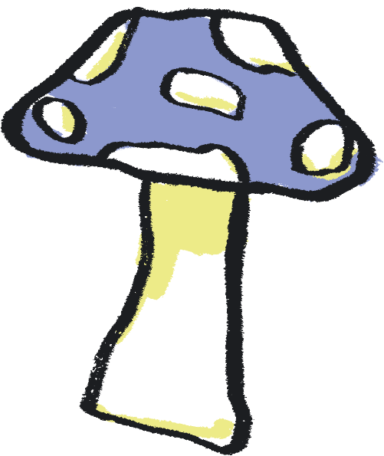
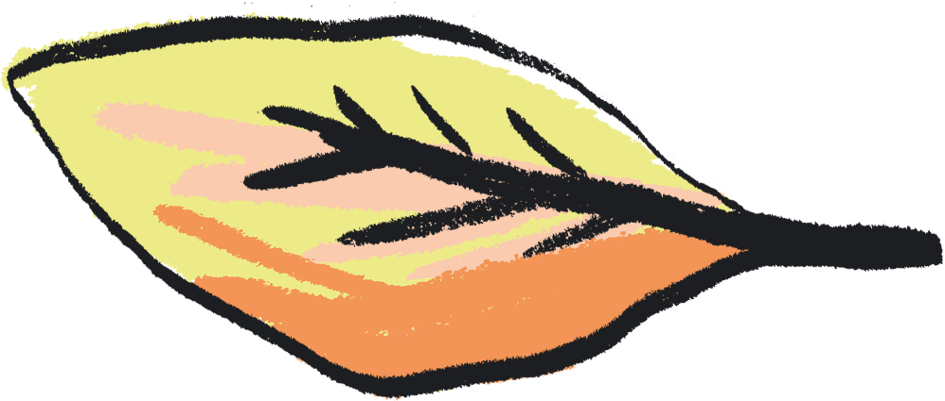
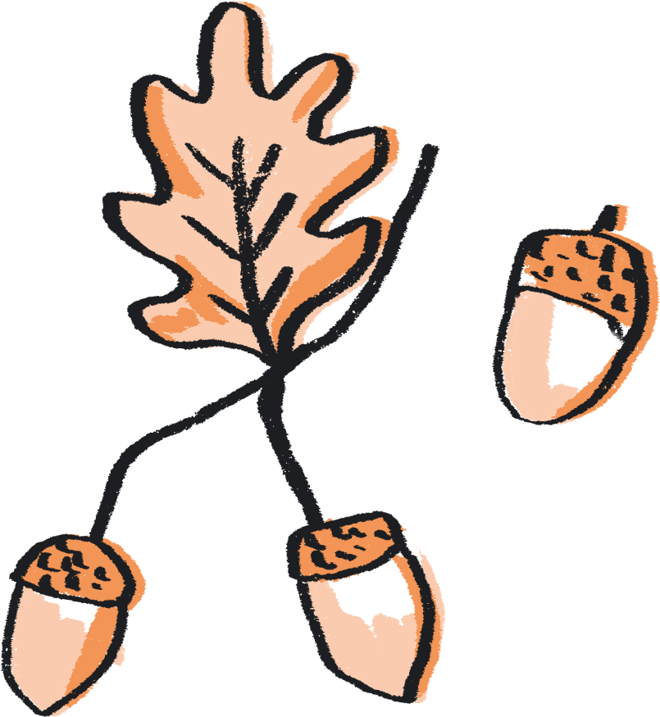
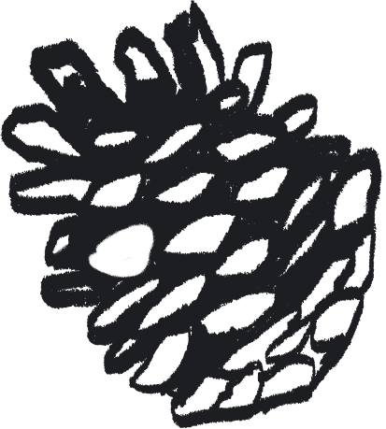
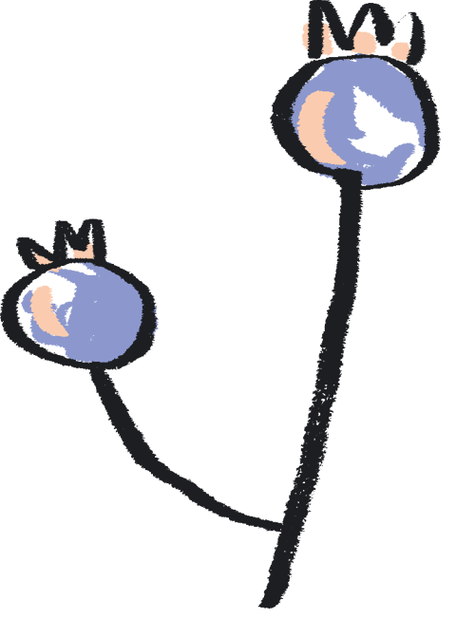
How to use this resource
You can use this resource in two ways:
As a live PowerPoint presentation for the whole class to view
As a printed pdf
Each year group has a dedicated set of slides.
The main content of each slide is directed at the pupils.
This content is animated to ensure that the teacher is in control of the pace of the lesson.
Each slide also has a corresponding set of ‘notes’, which are directed at the teacher.
To use the resource in PowerPoint Slide Show mode:
Go to the slide you wish to begin from
Click ‘Slide Show’ tab in the top navigation bar
Click ‘From Current Slide’ in the menu bar
To see the notes in this mode, click on the ‘…’ in the lefthand corner and select Presenter View
To view the notes:
Click on the View tab in the top navigation bar
Select ‘Notes’ to see these at the bottom of each slide

Slide 5
About this Resource…
Our Teacher Lab resource pack supports both creative practice and scientific enquiry in the classroom. We aim to offer teachers access to a variety of art experiences, aligned to each year group’s science curriculum. Through these activities, we hope to introduce exciting ways to combine the deepening of scientific knowledge and skills with the development of creative practice. Each activity also aims to embed scientific understanding and help children to ‘know more and remember more’ about the chosen topic.
We chose the working scientifically skills of ‘identifying and classifying’, as these are skills which run throughout the primary curriculum. We have chosen ‘Nature’ as a theme across all of the activities, offering ways to broaden children’s experience and understanding of nature and their place within it. Each nature-based topic has been selected from the National Curriculum and for reception the Early Learning Goals, to ensure each is as relevant as possible.
With reference to this knowledge base, we demonstrate how arts practice can be used to reinforce the skills and processes of identifying and classifying. For each year group, we have chosen a different art-based skill to provide teachers with a wide repertoire of creative ideas. We hope that these might be a starting point to enable teachers to use these creative practices to reinforce learning in other curriculum areas.

Slide 6
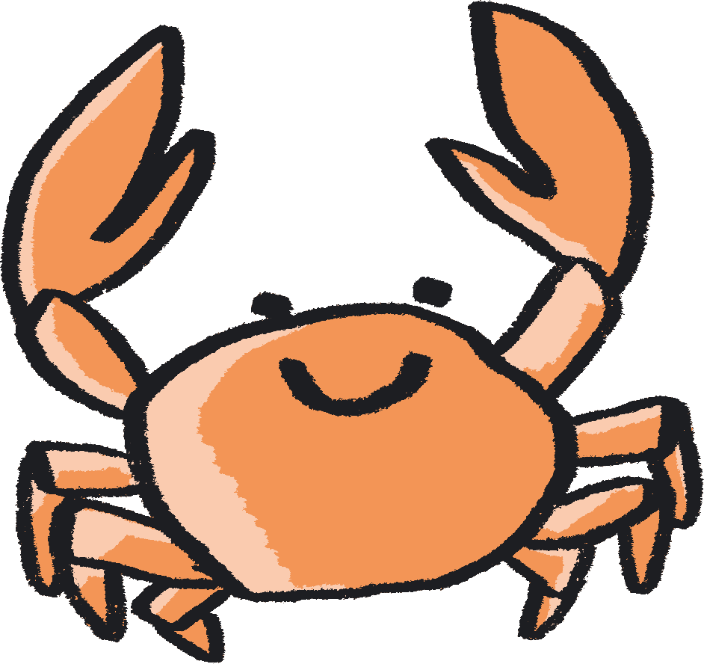
Each activity is designed as a mini project brief for your class, they are jumping off points to take in whichever direction best suits you. We encourage you to follow the natural curiosity of the children you’re working with and adapt the activity how best you see fit.
In terms of work with SEND children - each child is of course different, so when working with this resource, feel free to pick and choose activities which feel most suitable for them, depending on how they feel that day. Feel free to get creative with the activities and adapt them to your child's needs to create the best experience possible.

Slide 7
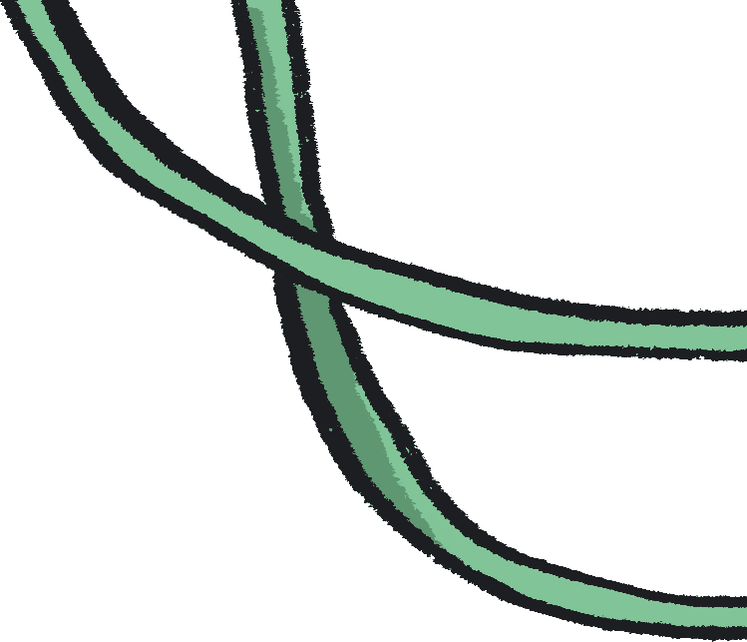
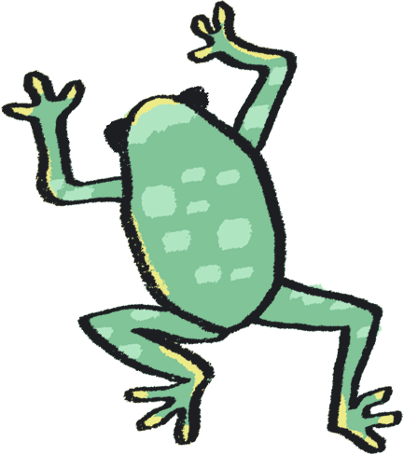
Author Statements
Gill Sekatawa, Art and Design Lead, Nelson Academy:
My aim for the resource was to provide a range of activities and experiences which will not only allow students to soak up the knowledge but also that allowed all involved to acquire transferable skills in art and problem solving to use in their future learning.
Prior to this Teacher Lab project, we had recently explored art and poetry with Kaitlin as part of Barbican Box in West Norfolk, which was an amazing experience. When the Barbican and Creative Arts East approached us about working together again, but this time in the suggested area of Science, it became immediately clear that we should involve Sarah, my teaching team colleague. As Science lead for our school, she is tasked with ensuring that, working scientifically, children will know and remember more. From my experience, there is no better way of making knowledge 'stick’ than using art and creativity to make learning engaging.
Sarah Melia, Science Lead, Nelson Academy:
I came at this project as a novice artist, intrigued to learn how art and science could mix and how creative practice could help children to enjoy working scientifically as well as know and remember more about a chosen topic. I wanted to choose a working scientifically thread which would run through all year groups in the hope that we would reach as wide a teacher and pupil audience as possible. By having this common thread link all the year groups’ activities together, the aim is that teachers will be able to adapt art activities from other year groups to use with other knowledge areas in their own year group, thereby creating a bank of resources whose application is potentially much wider than that originally written. As a science lead, I wanted not only to improve my own creative practice, but also to introduce a range of activities that could be adapted and used in different contexts, so that they could support the teaching of schools’ individual science curriculums, no matter what the unit’s knowledge base.

Slide 8
Author Statements continued…
Kaitlin Ferguson, Artist:
It has been really inspiring to work on this collaboration with both Gill and Sarah, and to create a resource which draws upon areas of the curriculum which we each feel very passionate about. It has been a fascinating process, which has allowed us to find inspiration from each other's passions and knowledge.
When we began creating the resource, we agreed it was really important that each set of activities felt truly balanced between art and science. We saw science as an inspiration for making art, and creativity as a means to explore science on a more meaningful level.
Art is a dynamic subject which has the ability to work in tandem with any subject in the curriculum, to bring greater depth and understanding. During our initial chats, we realised that classifying and sorting was not only a science skill which is relevant to each year group, but it also is a skill found in art. For example, curation is simply the sorting and organising of artworks. Therefore we designed the activities to have identifying and classification at the heart of them.
It’s been really enlightening to learn about the curriculum in greater detail, from those who are actively teaching it. This has allowed me to absorb and learn from the amazing teaching of Gill and Sarah. Like most teachers, Gill and Sarah have to come up with infinite new ideas and activities for their pupils regularly, under pressure of time constraints. Therefore, it has been really rewarding to create a resource which is designed both for ease of use for the teacher but also full of excitement and wonder for the children.
We hope that the resource offers teachers an exciting and ambitious set of ideas, rooted in the curriculum, to help grow the confidence, knowledge, and creativity of children.

Slide 9
with Reception
Notes:
Curriculum links: ELG: The natural world: Explore the natural world around them, making observations and drawing pictures of animals and plants.
Curriculum links: ELG: Creating with Materials: Children use and explore a variety of tools and techniques, experimenting with colour, design, texture, form and function; Share their creations, explaining the process they have used.

Slide 10
Classification activity
Sorting Natural objects using criteria
You will need...
Variety of natural objects to compare their qualities
(E.g. pebbles, twigs, conkers, feathers, flowers, leaves, pine cones etc)
Electrical tape or masking tape
A pair of scissors

Slide 11
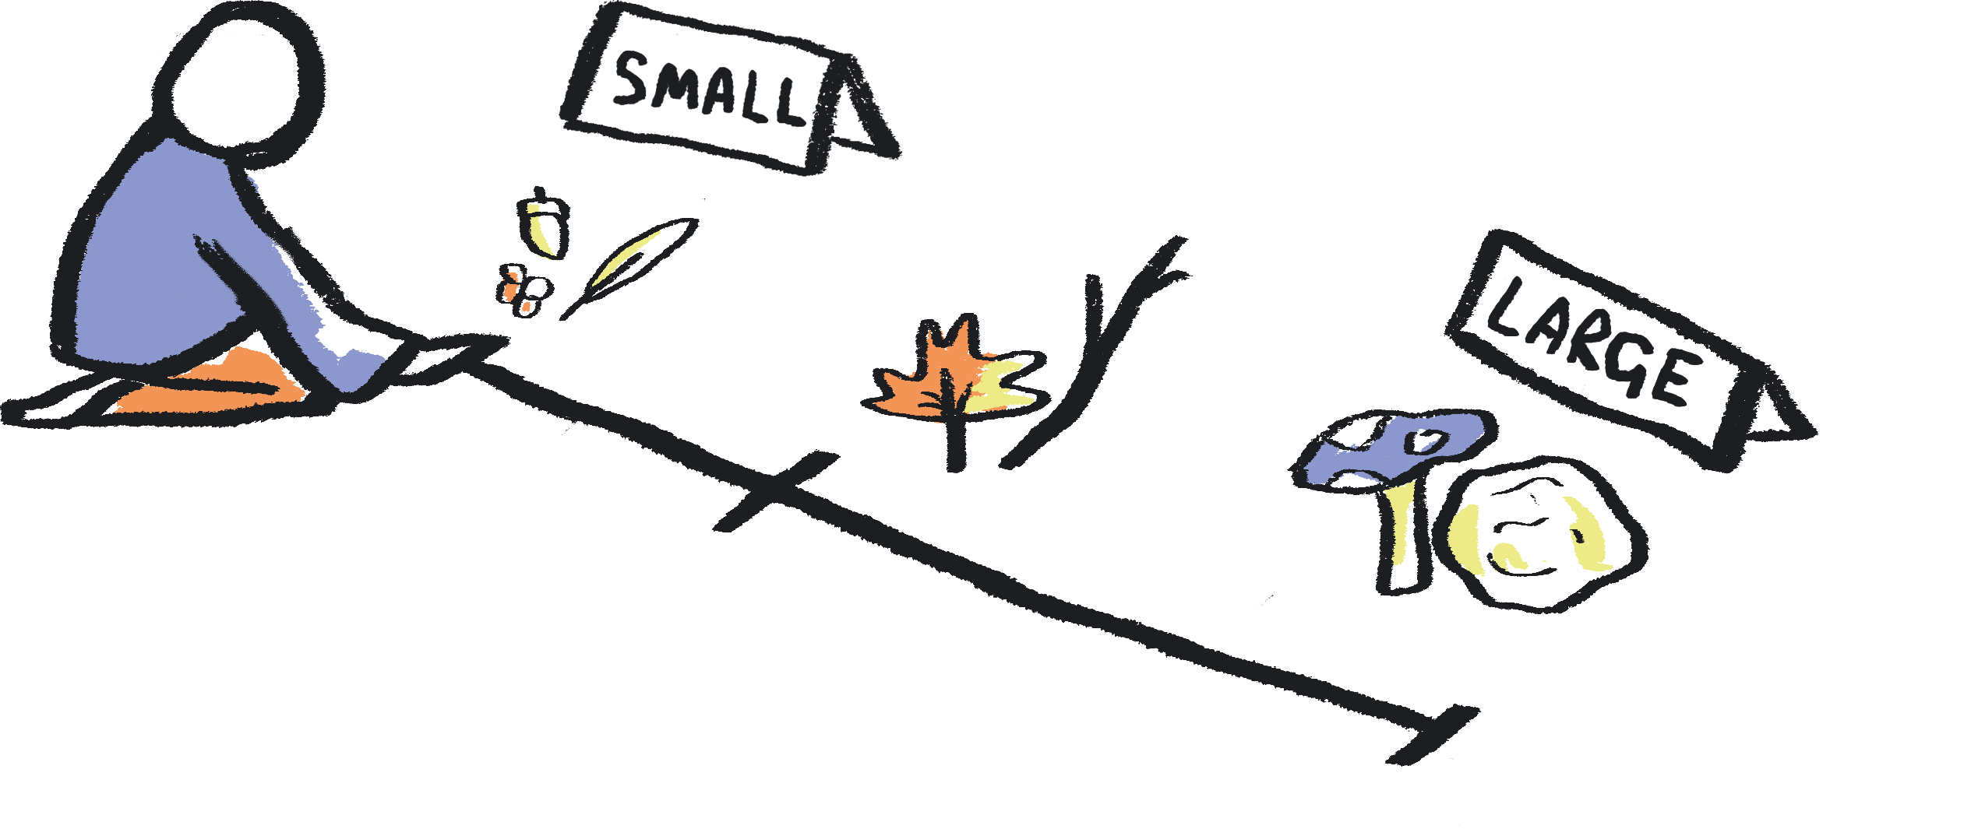
Create a scale for the group by taping a strip of electrical tape on the floor.
Work as a group to sort and order materials according to different qualities or categories.
These could be:
Sort by texture (smooth to rough)
Sort by size (smallest to biggest)
Sort by weight (heavy to light)
Sort by colour (lightest/most colourful to darkest)
Or feel free to make up your own categories depending on the natural materials you have!
Notes:
PROMPTS FOR CREATIVE THINKING:
Students could be asked to think about which sense they will need to use to be able to sort by the different categories: e.g. which sense to identify colour? Which sense to identify weight? How could they use their other senses to create new and unusual criteria, and make different connections (e.g. using hearing to order objects according to which makes the most rustly noise).
Can students predict which will be the heaviest, or have the roughest texture just by looking? Or can they decide if statements from the teacher are true or false? e.g. - "this is the heaviest object". Then ask them to check these assumptions through further exploration. Was there anything that was surprising?

Slide 12
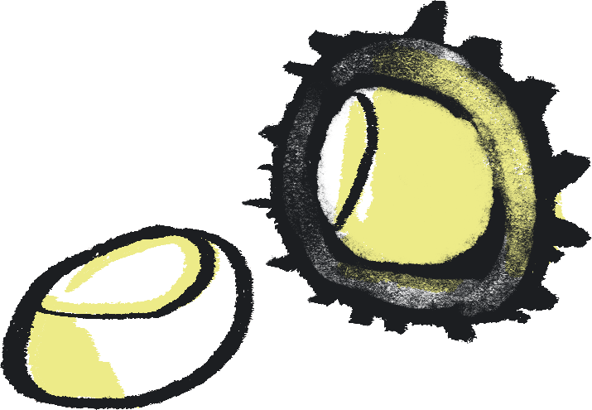
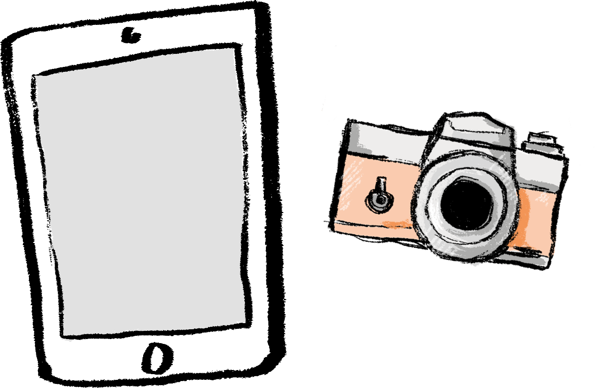
Art activity
Medium: Photography
You will need...
Natural objects from your classification activity
(E.g. pebbles, twigs, conkers, feathers, flowers, leaves, pine cones etc)
An iPad or digital camera (one per group)
A printer
Notes:
Using the natural materials from your classification activity, take a series of close up photographs of your objects exploring different textures and sizes.
These photographs can then be use to discuss different textures and qualities of your natural objects as part of retrieval practice.
Or alternatively use these images to put up a mini exhibition!
Optional Extra: Laminate your pictures or stick them onto magnetic backing to make magnets.

Slide 13
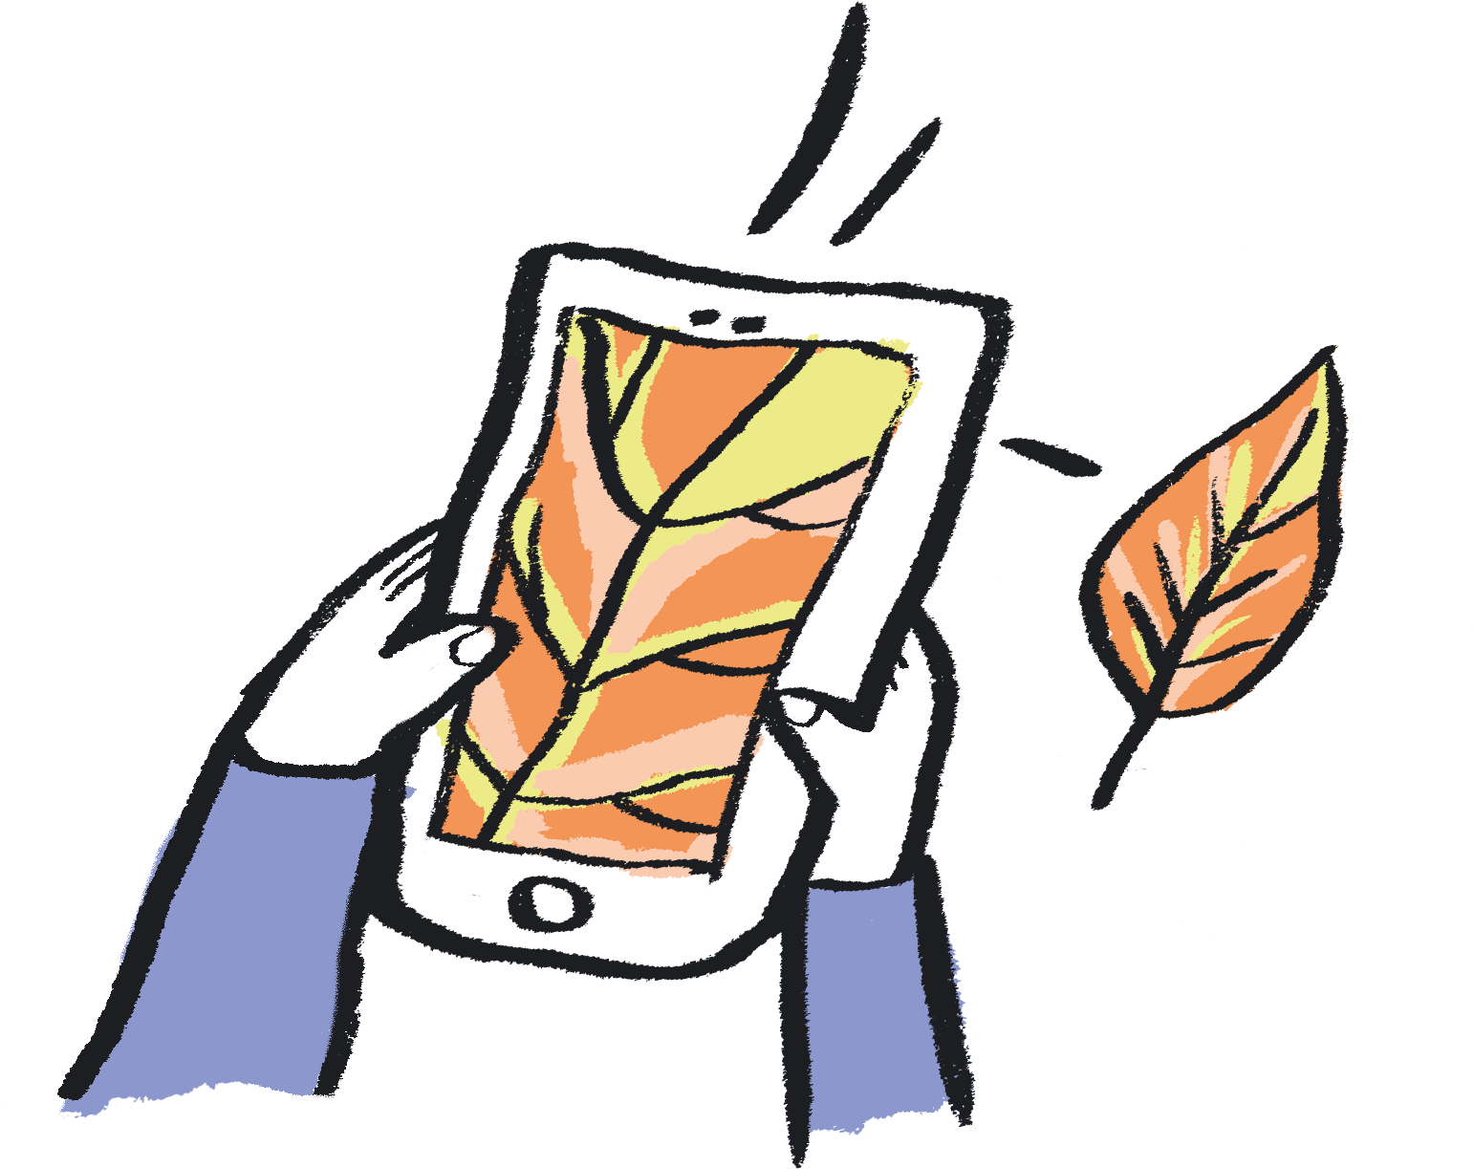
Take some close-up photographs of the natural objects from your classification activities.
You can take these images by zooming in or using macro settings on your camera.
Change the images into black and white.
This can be done using picture settings on your iPad, camera or print setting on your computer.
Print your images.
Can you work out which each one of the close-up images is of?
Can you order them, using the same categories as the Classification Activity?
Notes:
Where possible try to support the children to take the photographs, thinking about photography as a form of art making.
Using the images, have a discussion with the children about what they think each one of the close up images is of and why. Once they have figured out what the photographs are of, you could get them to order them, via the same categories as the Classification Activity.
Alternatively, you could create a mini-photography exhibition of the children's photographs and get them to describe the objects they photographed.
PROMPTS FOR CREATIVE THINKING:
Is there anything that this exercise helps them to notice about the objects? Are there any hidden details that appear? Students could make a list of any questions about the items that this raises, which could be explored in future lessons.

Slide 14
Andy Goldsworthy
Andy Goldsworthy is a British artist, who uses natural materials to create site-specific artworks which explore the relationship between humans and their natural surroundings.
Kate MccGwire is a British sculptor who specialises in using the feathers, as a natural material, in her work.
Gill says: “Nancy Holt was an American Artist from the Land Art movement. She connected with the landscape in her art. Her sculpture ‘'Sun Tunnels’’ her most famous work, uses the play of sunlight through huge concrete cylinders to capture change. In the classroom you could take cardboard tubes and use them as viewfinders to observe the natural world around you.”
Kate MccGwire
Nancy Holt

Slide 15
with Year 1
Notes:
Curriculum links: Identify and name a variety of common wild and garden plants, including deciduous and evergreen trees.
Curriculum links: Identify and describe the basic structure of a variety of common flowering plants, including trees.
Curriculum links: Practical scientific methods, processes, and skills: Identifying and classifying.

Slide 16
Classification activity
Observe closely, perhaps using magnifying glasses, and compare and contrast familiar plants; describe how they were able to identify and group them.
You will need...
Coloured electrical tape, masking tape or hula hoops to make 'sorting circles' on the floor.
A variety of leaves.
Notes:
Resource note: Leaves could be collected before the lesson or during an outdoor lesson.

Slide 17
Have a careful look at a variety of leaves you've collected.
What words would you use to describe the different leaves?
Look carefully. What similarities and differences can you notice?

Slide 18
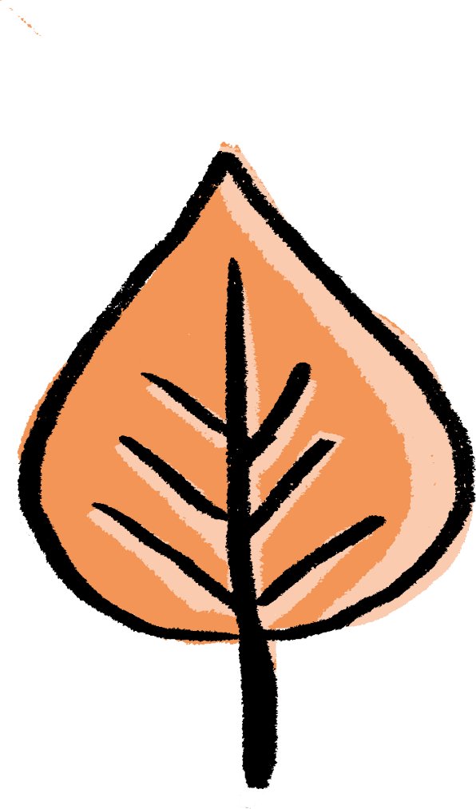
continued…
Draw a set of circles on the floor of the classroom using your tape or hula hoops!
Work together to sort the leaves according to different categories.
These could be:
Classify by type: evergreen or deciduous
Classify by size
Classify by texture: smooth or rough
Classify by shape
Classify by colour
Or you could even come up with some of your own categories as well!
Notes:
PROMPTS FOR CREATIVE THINKING:
How many different ways and methods can students think of to explore the characteristics of their leaves? What senses can they use?
Possible Extension: If resources permit (or using photographs), classify by seasons.

Slide 19
When looking for different criteria, be sure to come up with reasons for each of your choices.
Some leaves might be able to fit in more than one category so you could put them in overlapping circles (e.g. like a Venn diagram).
Some leaves might not fit into any of your categories and might need to go on the outside of your circles - that’s ok too!
Notes:
PROMPTS FOR CREATIVE THINKING
If there are leaves which can't be classified, what can be done? What further research could be done to help to classify them? Are there any categories not already thought of which could help?
Students can discuss their rationale for classification, and try to agree as a group. How can any disagreement be resolved? Does it need to be resolved? Are there other examples of disagreements or debates in science?

Slide 20
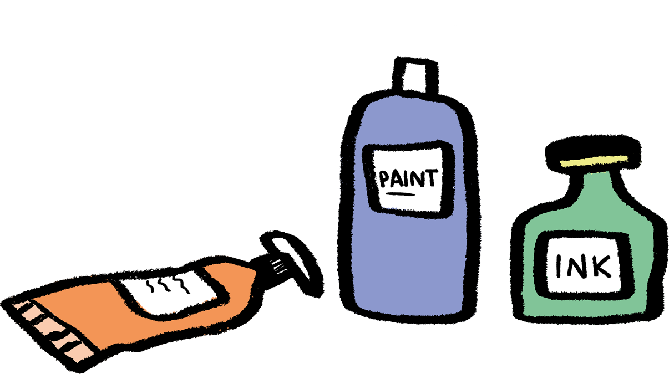
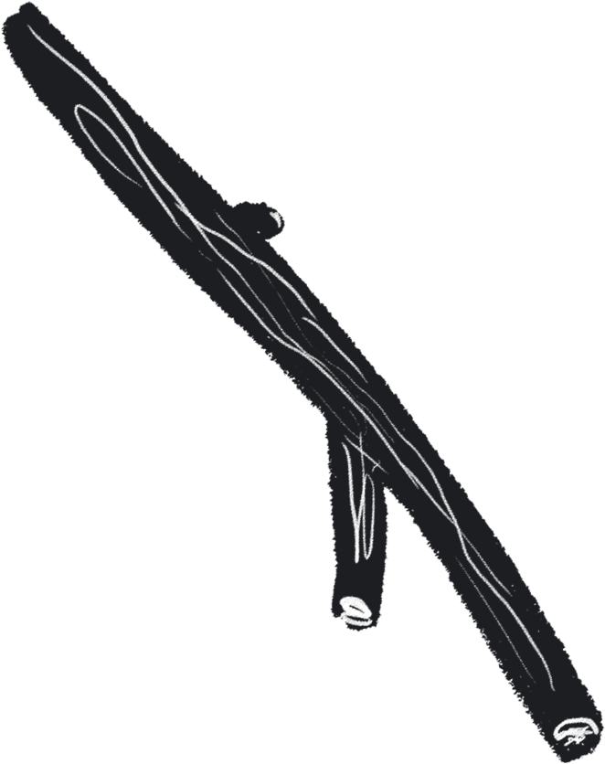
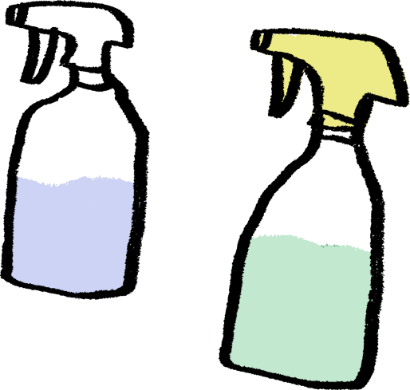
Medium: Printmaking
Art activity
Create prints, sort them and make a science/art display to link back to the classification activity.
You will need:
Natural materials e.g. leaves, flowers, pine cones, twigs etc
Newspaper or table covering
Some paper
Spray bottles and water
Paint or natural inks

Slide 21
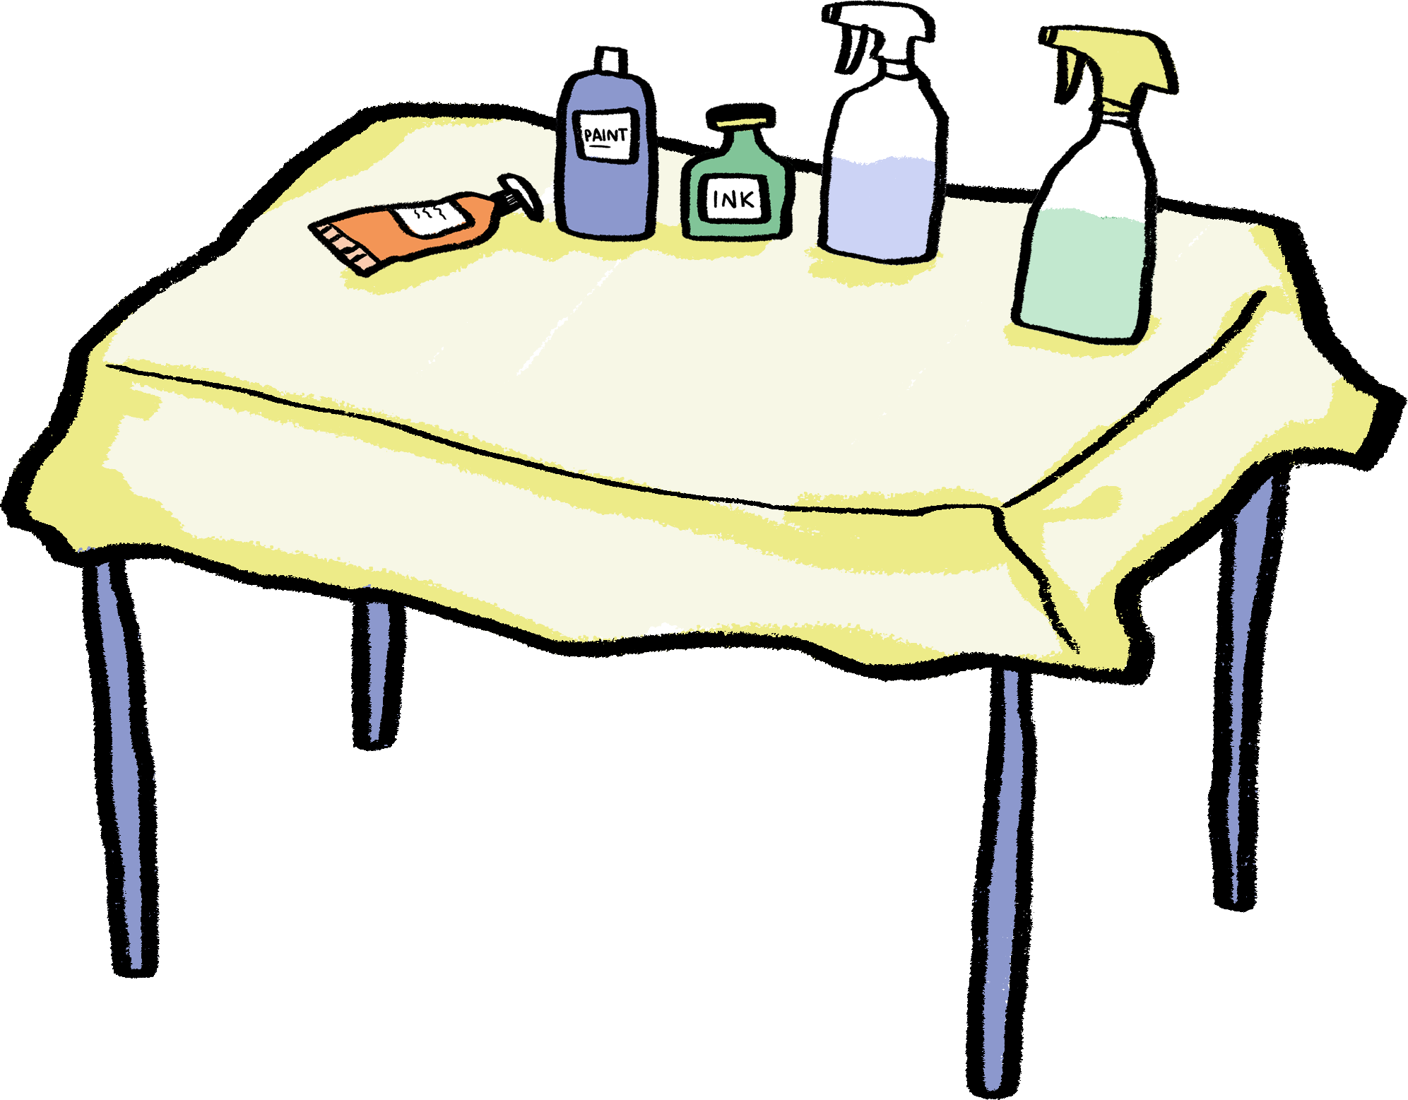
Choose a selection of leaves from the sorting activity.
Set up your work area and cover the table you are working on with either newspaper or a tablecloth.
Fill the spray bottles with a mixture of water and either paint or natural inks.
Notes:
PROMPTS FOR CREATIVE THINKING:
Which leaves do students think will make the best stencils and why? Can they predict which characteristics will have the most visual impact?

Slide 22
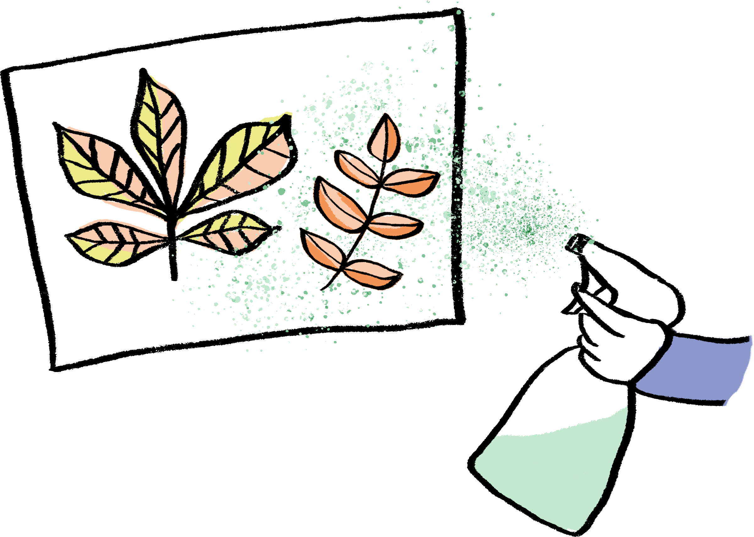
continued…
Arrange the leaves or natural objects in a composition on your paper.
Spray them with your spray bottle.
Try spraying from different directions to capture as much detail as possible.
You could also experiment with using different colours or layering different objects.
When you are finished, lift up your leaves to reveal your Natural Stencil Print!
Notes:
PROMPTS FOR CREATIVE THINKING
Students can reflect on the outcome of their stencil print - is there anything they would do differently next time? More / less paint, spraying from a different angle, etc? Students can try these out in further attempts.
Discussion - were there things that students found difficult when making their prints? How did they overcome this? How can they use this learning in the future?
Possible Extension:
After the art activity has been completed, re-create the sorting circles, this time showcasing the artwork you have produced.
Add speech bubbles to say which leaves made the best stencils and why you made the classification decisions you did.
Create your very own exhibition wall display!

Slide 23
Kaitlin says: “Lorenzo Duran is a Spanish self-taught artist who carves beautifully detailed artworks into leaves. He was inspired by watching how a caterpillar made holes in a leaf by eating it!”
Andy Goldsworthy is a British artist, who uses natural materials to create site-specific artworks which explore the relationship between humans and their natural surroundings.
James Brunt lives and works in Yorkshire and creates artworks using leaves to make patterns and shapes. What patterns can you create using the leaves you have collected?
Lorenzo Duran
Andy Goldsworthy
James Brunt

Slide 24
With Year 2
Notes:
Curriculum Links: Identify that most living things live in habitats to which they are suited and describe how different habitats provide for the basic needs of different kinds of animals and plants, and how they depend on each other.
Curriculum Links: Identify and name a variety of plants and animals in their habitats, including microhabitats.
Curriculum Links: Practical scientific methods, processes and skills: Identifying and classifying.

Slide 25
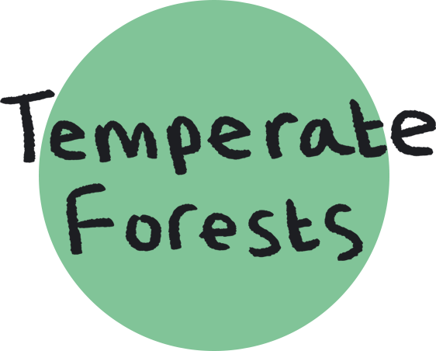
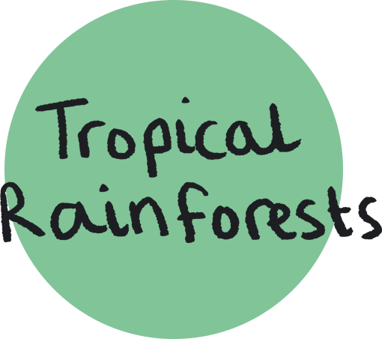
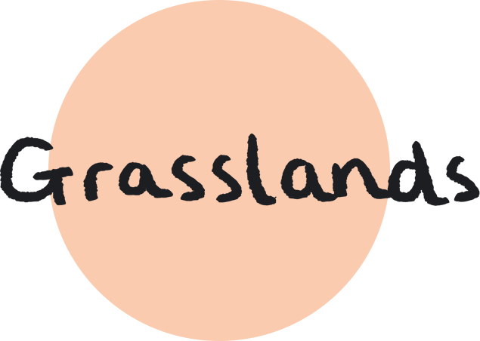
Art activity
Medium: Making Sketchbooks / Collage / Painting
Have a go at creating your very own habitat concertina sketchbook.
Your sketchbook could have a page for each of the seven habitats.
Quiz: Can you remember what these are?
Notes:
These sketchbooks will become a tool for sorting and classifying.
Each page will become the background to create a scene where children can sort different animals and plants into their correct habitats.

Slide 26
You will need:
Scissors
Pencil
Tape measure or metre stick
Large piece of thick white paper or card - ideally A1 (You should be able to make 3 sketchbooks per one A1 sheet)
Option 1 - Materials to collage e.g. paper/printed imagery
Option 2 - Materials for painting e.g. paints/brushes/palettes
Notes:
Resource note:
If you do not have access to A1 paper, you can substitute this for A3 paper and use 2 sheets folded in half and stuck together.

Slide 27
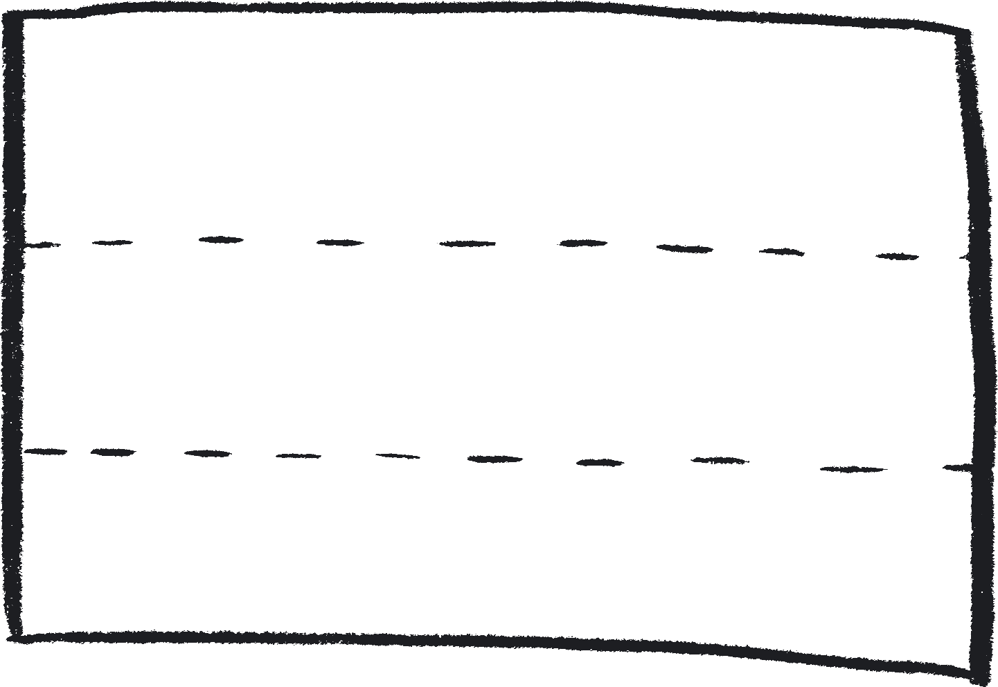
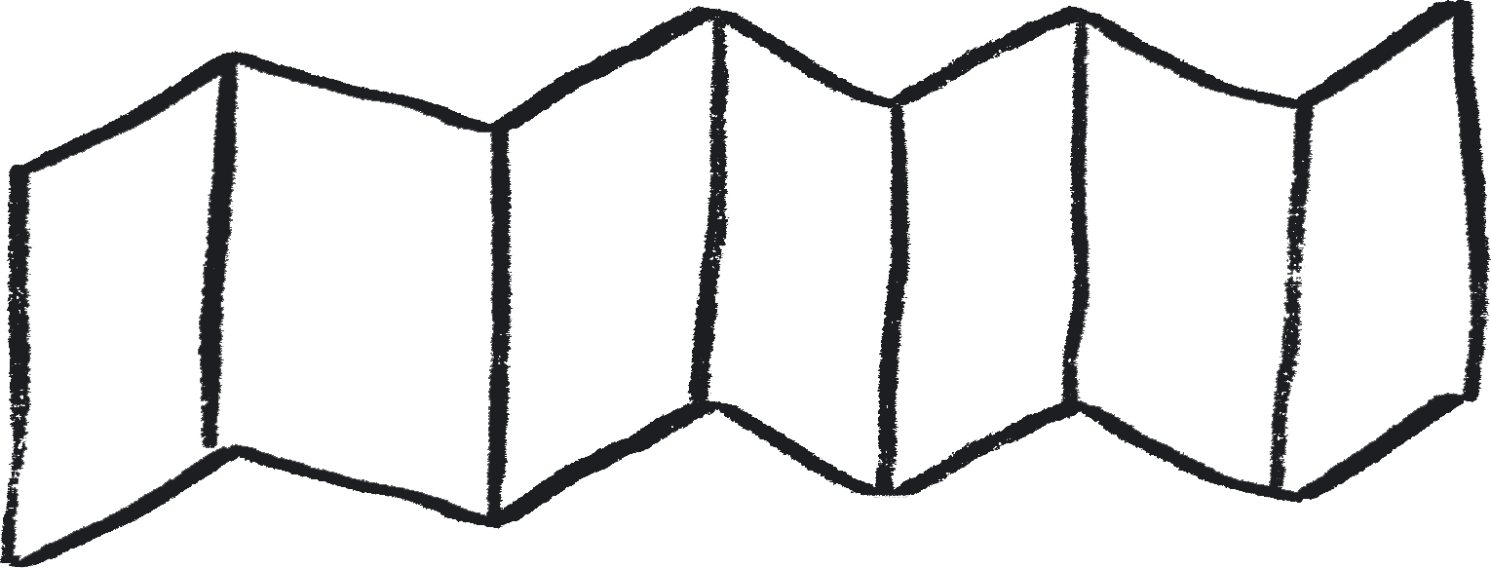
First, create your concertina sketchbook:
Cut your A1 piece of paper into 3 sections length ways.
With one of these strips, fold it over and then back on itself in 12cm wide sections 7 times to create the sketchbook of 7 pages.
Notes:
Each strip should be approximately 20cm in width
Each page section should be 12cm across

Slide 28
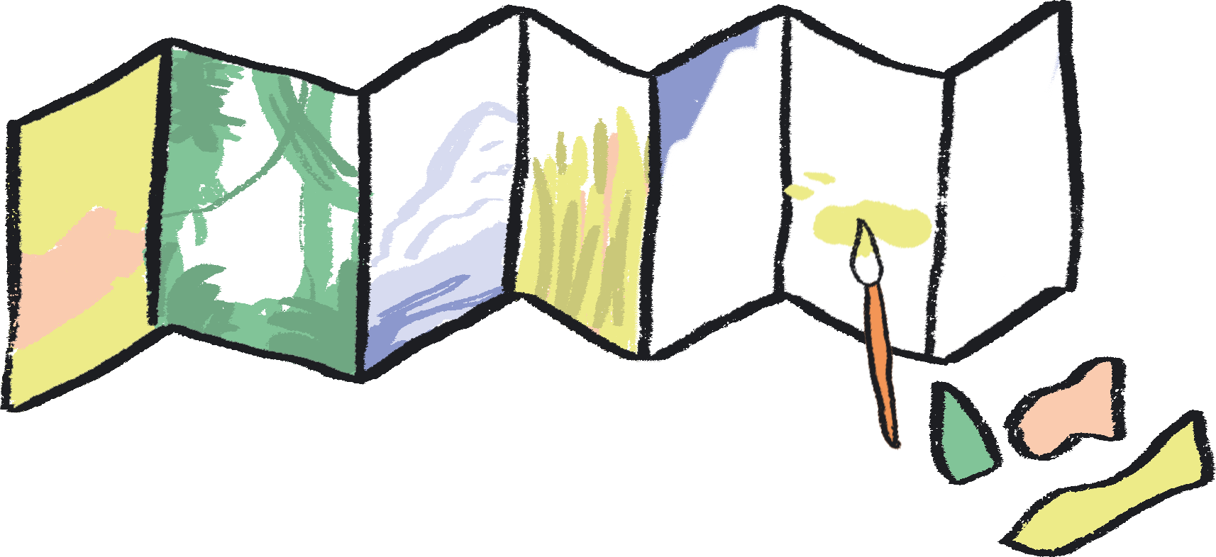
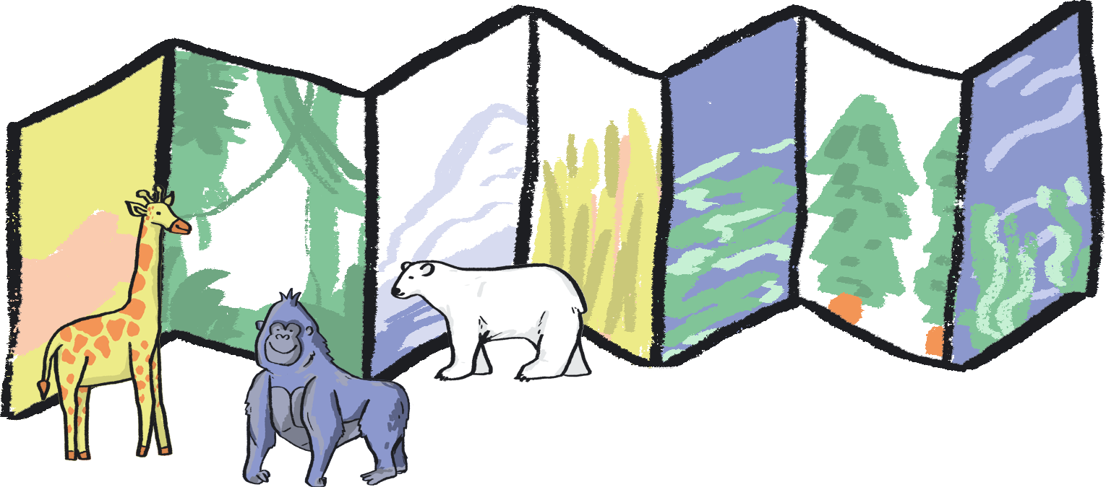
continued…
On each of the pages of your sketchbook, create a background scene from one of the seven habitats (or just choose a few and use more than one page for each).
You could do this by collaging photos or images, or by painting different scenes.
Once your sketchbooks are decorated and dried, you can prop them up on a table and use them as a background scene to sort your animals or plants into each one of the seven habitats.
You could do this by using animal toys or laminated printed images of the different species.
Notes:
Possible Extension:
You could extend the activity by discussing colour mixing and ways to create textures (e.g. a sandy desert, or smooth polar ice).

Slide 29
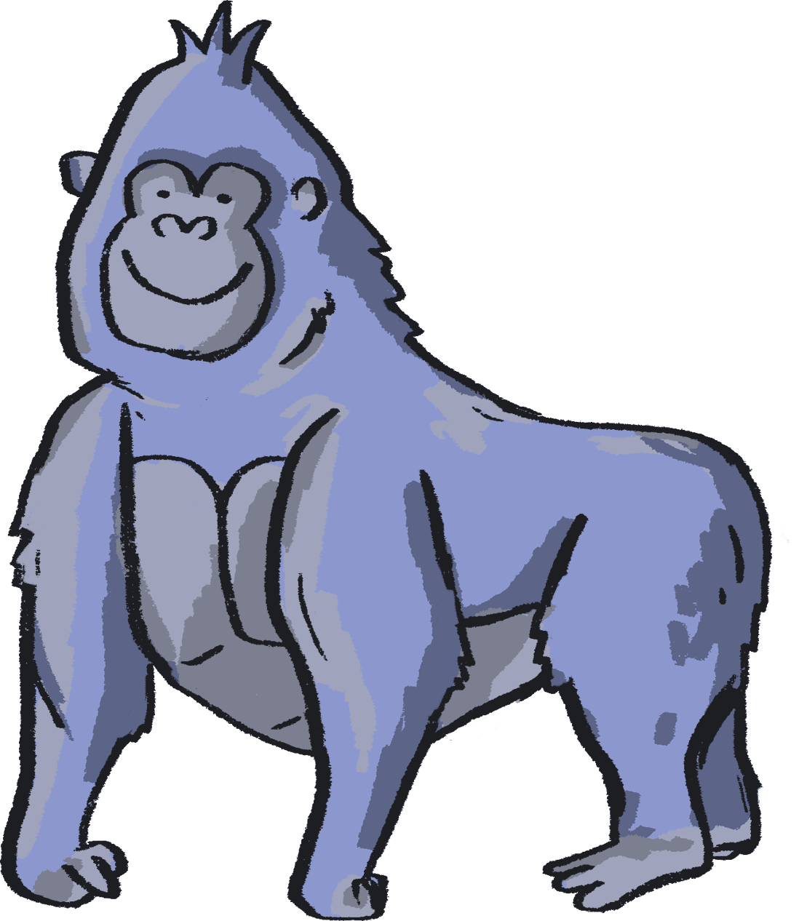
Classification activity
Group animals according to their habitats.
You will need:
A variety of animals/plants from each habitat.
You may wish to use model animals or print outs of photographs.

Slide 30
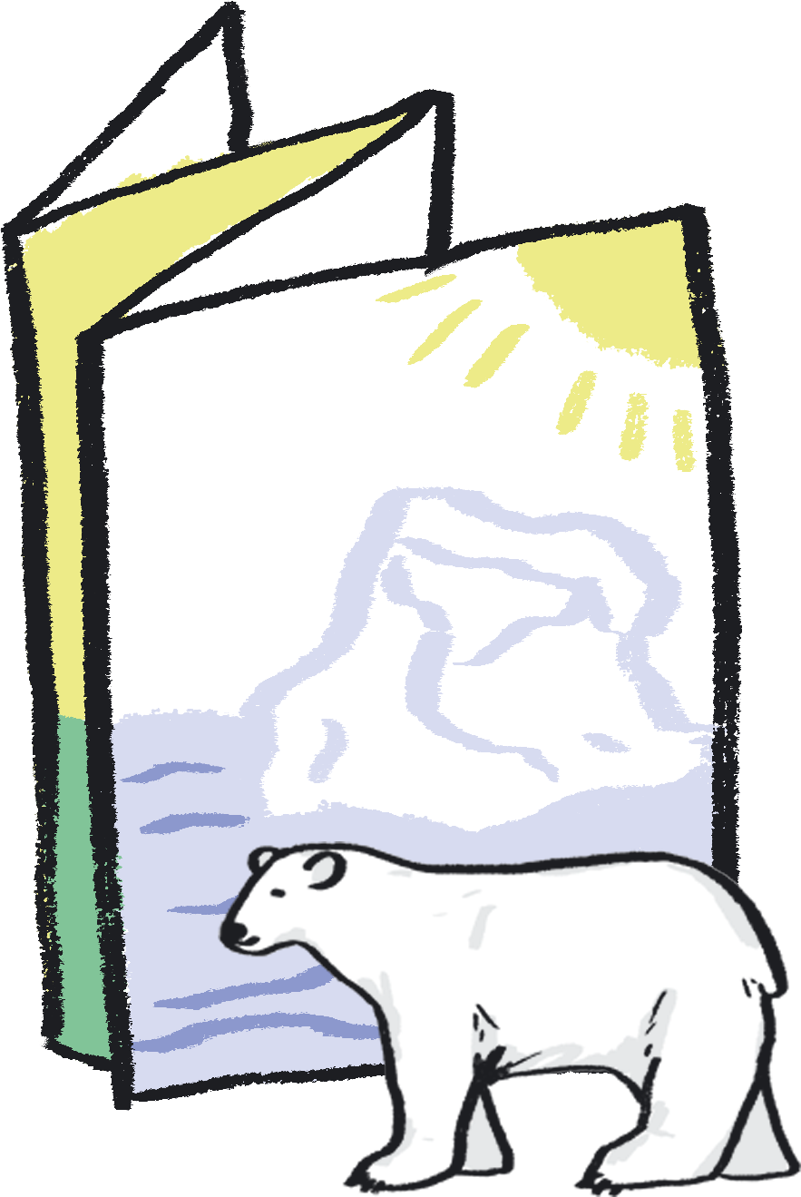
After you have made your concertina habitat sketchbook, have a go at sorting the animals/plants into their appropriate habitats.
Think carefully about what an animal or plant needs to survive in that habitat.
For example, a polar bear would live in a polar habitat because it has thick fur to keep it warm.
You could add labels or speech bubbles to your sketchbook to explain your choices.
Or you could take a series of photographs of your compositions.
Notes:
PROMPTS FOR CREATIVE THINKING:
Students could share one piece from their sketchbooks with each other - what habitat does their partner think it shows and why? What kind, specific and helpful feedback can be offered (if appropriate)?
Can they think of imaginary or unusual habitats, and design the organisms that could live in them (using the knowledge they have gained?) E.g. what characteristics would an animal or plant need to live on the moon? Or in a cup of tea?
Possible Extension: Can the children link the plants and animals together by purpose? For example, X provides food, shelter, camouflage when hunting/being hunted.

Slide 31
Abel Rodriguez creates very detailed images which demonstrate his knowledge of the ecosystem of the rainforest. Abel grew up in the Columbian Amazon region, and his pictures are drawn entirely from memory.
Elisabeth Frink was a British sculptor and printmaking who has inspired by natural forms, in particular animals, such as birds, cats, horses as well as the human figure.
Albert Namatjira was an artist of the Western Arrernte people, a group of Aboriginal Australian people from Central Australia. He painted many images of the landscape of Central Australia, which included lush green hills as well as dramatic rock formations and arid desert.
Abel Rodriguez
Elisabeth Frink
Albert Namatjira
Notes:
Possible Extension:
Choose some animals from the Sainsbury Centre for Visual Arts collection - there are lots! www.sainsburycentre.ac.uk
Which habitat would suit them best?
How could you create a safe space: camouflage?
Which features does your habitat need for your animal to survive?
Match the animals to some of your habitat concertina sketchbooks.

Slide 32
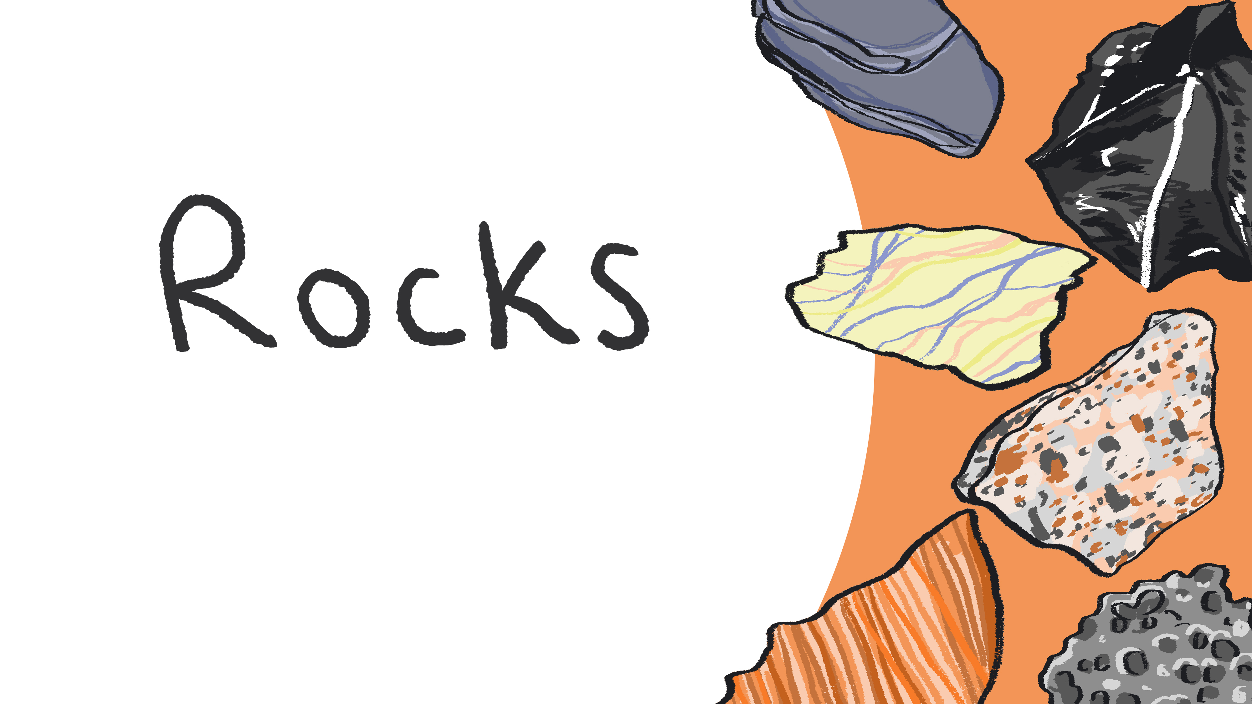
With Year 3
Notes:
Curriculum Links: Compare and group together different kinds of rocks on the basis of their appearance and simple physical properties

Slide 33
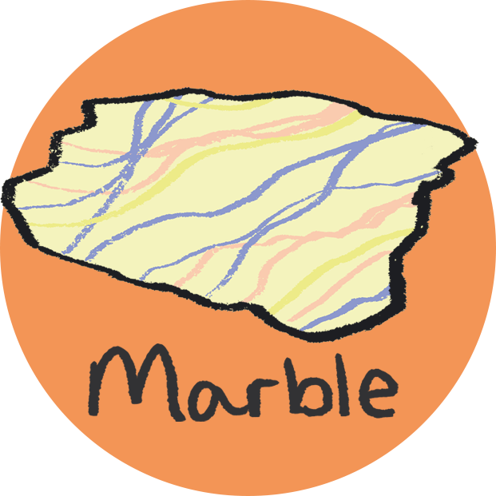
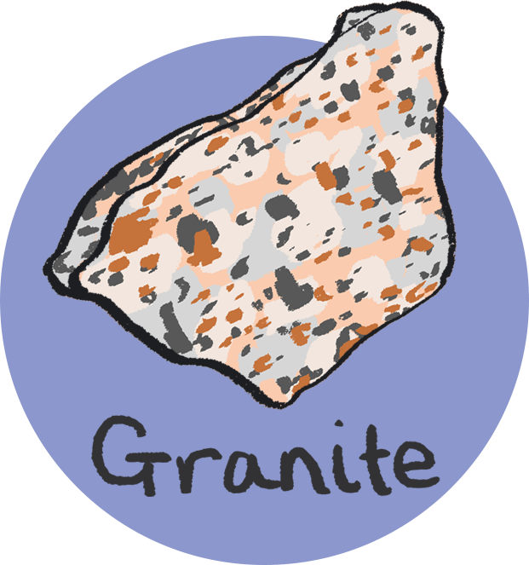
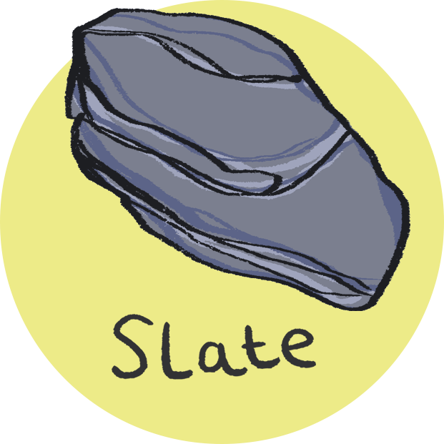
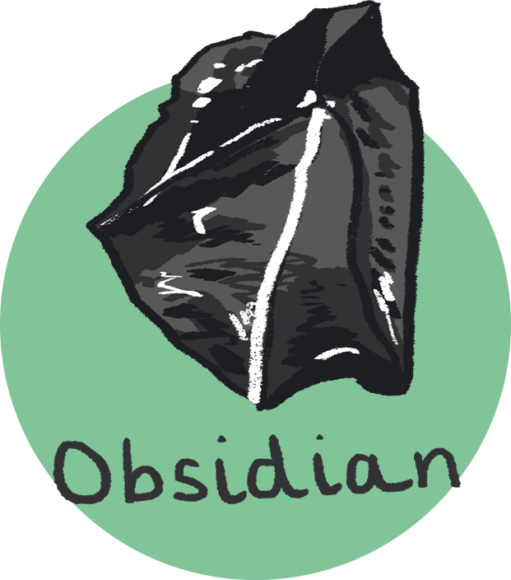
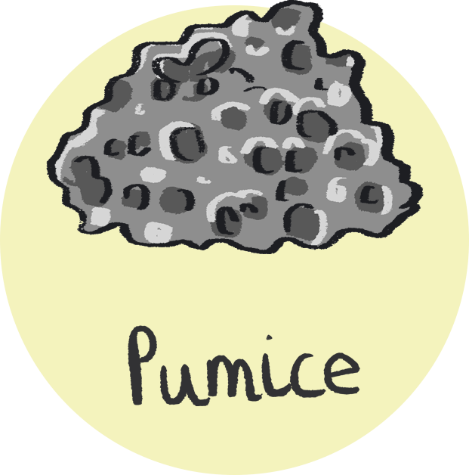
Classification activity
Compare and group together different kinds of rocks on the basis of their appearance and simple physical properties
You will need:
Rock Identification Chart (next)
Variety of rock samples including marble, granite, sandstone, slate, pumice, obsidian.

Slide 34
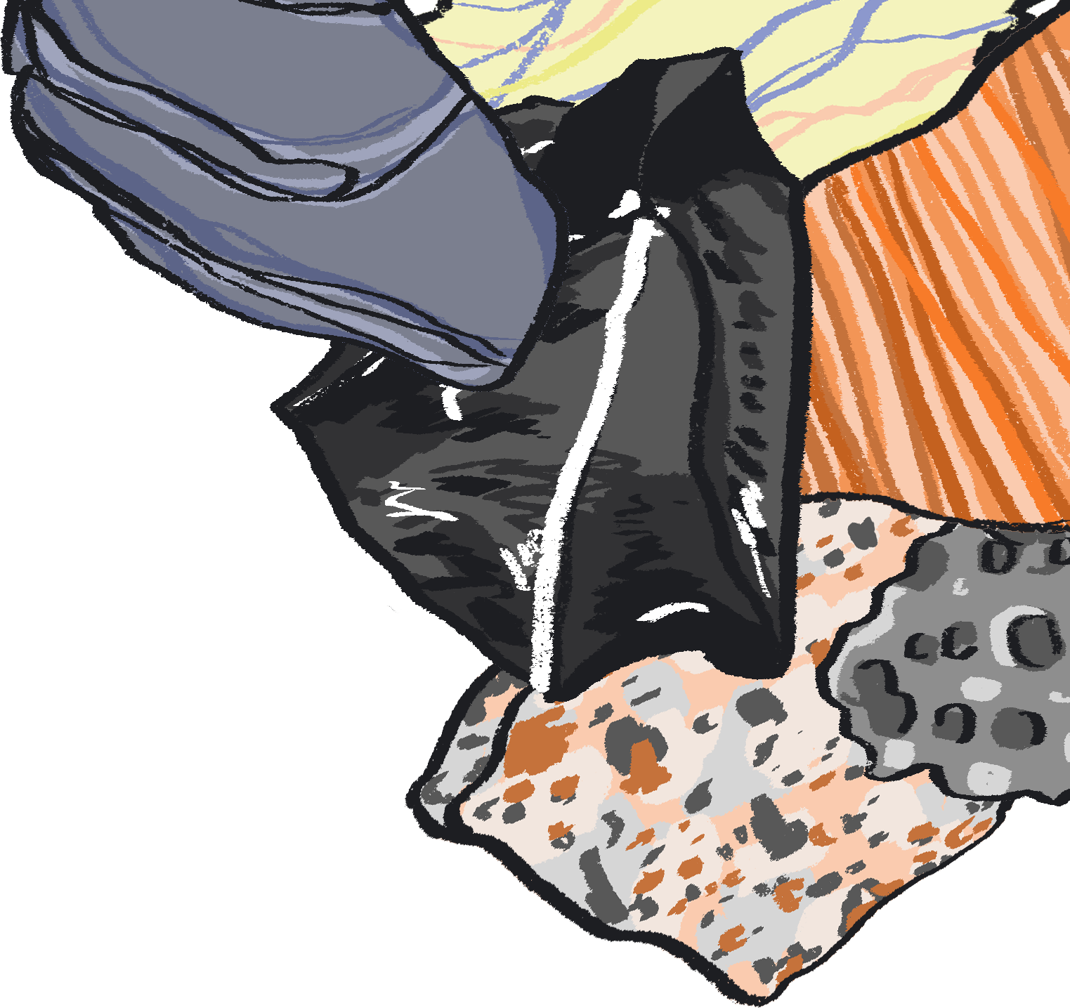
Does the rock have more than one colour?
Yes
No
Does the rock look like it has veins in it?
Does the rock have visible layers?
Yes
No
Yes
No
Marble
Does the rock look like it has crystals in it?
Does the rock have visible grains?
Does the rock look like it is full of holes?
Yes
Yes
No
Yes
No
Granite
Sandstone
Slate
Pumice
Obsidian

Slide 35
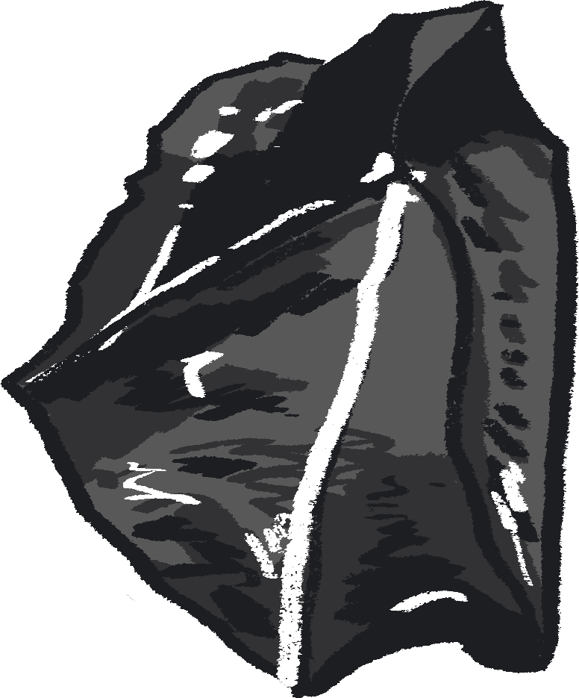
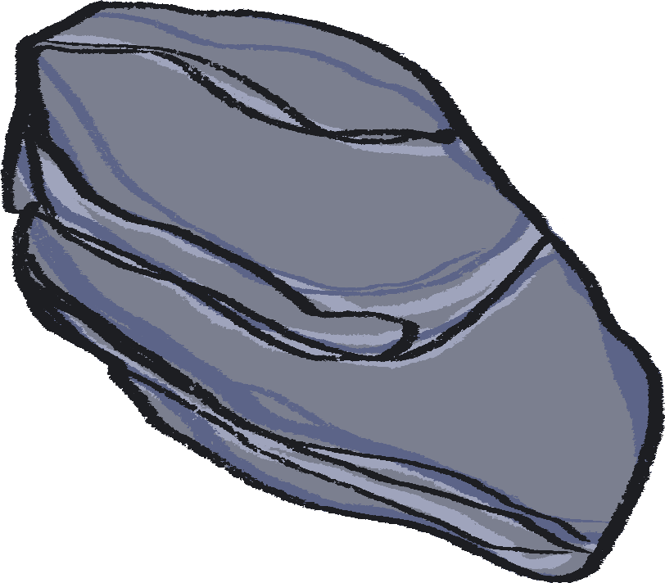
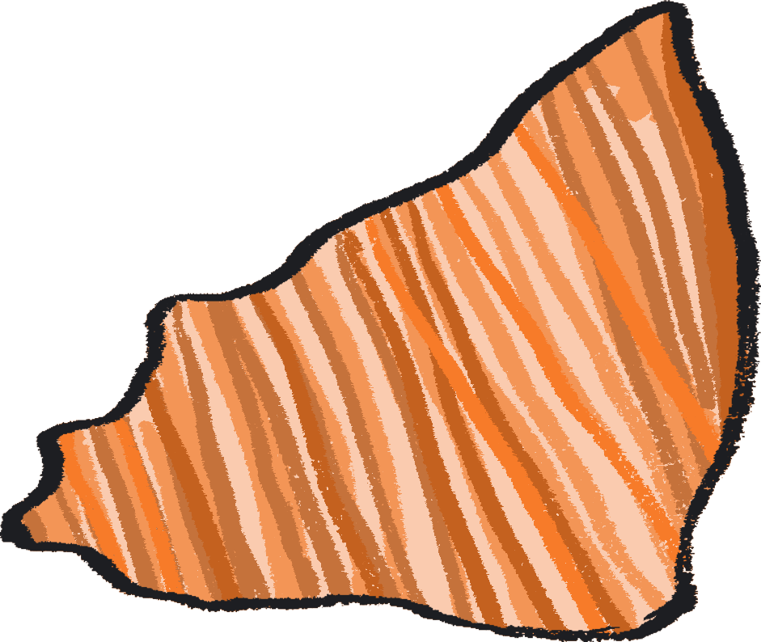
Have a careful look at our rock identification chart, follow the key to see if you can identify different rock samples.
Next:
Start by choosing two rock samples.
What question could you ask to differentiate between them?
What questions could you ask to differentiate three rock samples?
Continuing this thought process, can you make your own key to identify the rock samples?
Notes:
PROMPTS FOR CREATIVE THINKING
To create their categories, students will need to make connections between the different rocks, as well as identify differences. With each new rock that is added, they will need to test out their questions, and see if they still work to identify the rocks, or whether they need to be amended or new questions added.

Slide 36
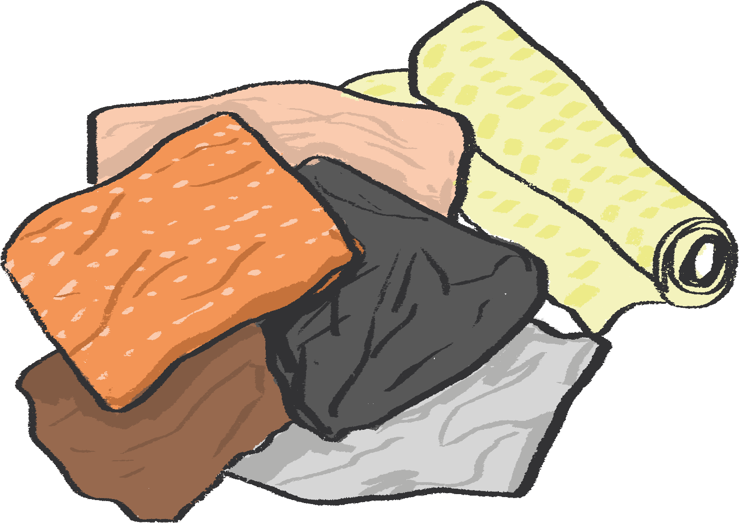
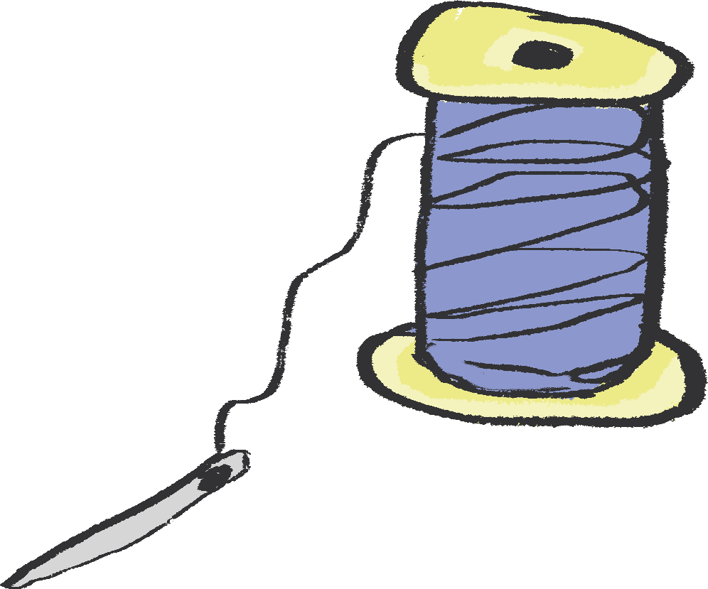
Art activity
Medium: Textiles
Create a geological artwork, which explores the different textures of rock as well as the layers the earth, using recycled materials!
You will need:
Selection of rock samples
Scraps of fabric (recycled if possible)
Magnifying glasses (optional)
A thicker piece of fabric as a backing e.g. canvas
Pencil and piece of paper
Scissors
Option One – Sewing: Pins, needle and thread in a variety of colours.
Option Two – Fabric glue (or if you don't have this PVA will work!)

Slide 37
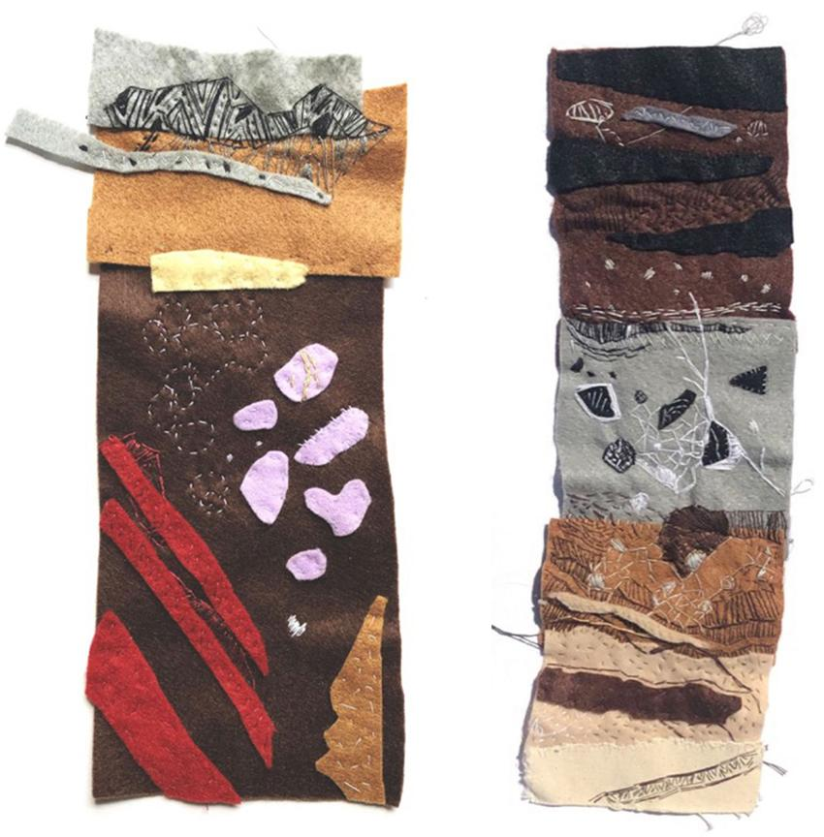
Begin by looking at the rocks you have classified and their different textures, looking carefully with your magnifying glasses.
Try sketching the patterns you see for inspiration.
Imagine digging up and looking at a 'borehole' or tunnel section of earth from 10000 metres below your feet.
Have a go at sketching what you think the layers would look like.
Fun fact: Each layer is called a 'strata'.
Kaitlin Ferguson's Soft Strata Artwork Example
Notes:
Possible Extension:
Children could research what types of rocks are found in your area or even make up their own!
You can find examples of Norfolk rock types and strata here: http://www.northfolk.org.uk/geology/index.html

Slide 38
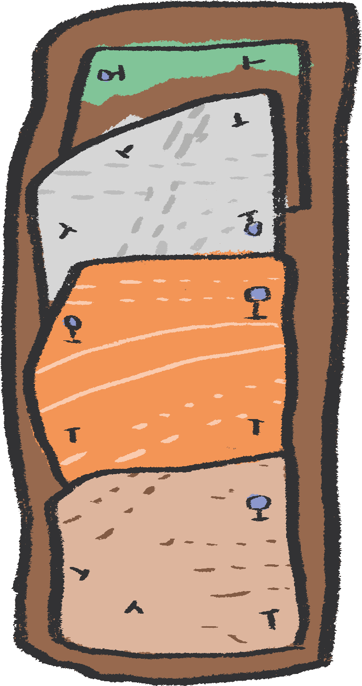
continued…
Once you have sketched your design, sketch it out onto your thicker backing fabric.
Choose some different fabrics to represent the different layers or rock types you have drawn.
Attach each layer to the base fabric by pinning it down with pins or a spare needle, then sew each layer on and remove the pins as you go. If you don't feel confident sewing, you can use fabric glue instead.
Once you have attached each layer of 'strata' you can begin to add detail of the different textures of your rock. You can do this by:
sewing on patterns
adding pieces of fabric in contrasting colours
experimenting with different threads and stitches

Slide 39
“I really like Julienne Dolphin-Wilding’s artwork 'Matrix Revealed' which is a public sculpture on display in Thetford Forest Park in Norfolk. It is a giant geological core sample showing what is deep underneath our feet.’’ Kaitlin
“What do you get when you combine geology and creativity? Take a look at Kaitlin's website and discuss her varied approaches to making art which draw on geology and science. You could take inspiration from Kaitlin’s prints and create your own series of artworks inspired by rock samples and fossils.” Gill
El Anatsui is a Ghanaian sculptor who works with recycled materials. He often creates installations using pieces of aluminium (aluminium comes from minerals found underground), which are sewn together using copper wire, to make large metal wall sculptures that look like they’re made of cloth. El Anatsui’s work often has lots of different colours, layers, shapes and textures within it.
Julienne Dolphin-Wilding
Kaitlin Ferguson
El Anatsui
Notes:
Possible Extension:
What do you get when you combine geology and creativity?
Take a look at Kaitlin's website and discuss her varied approaches taking inspiration from all things rock!
Use close examination of Kaitlin's screen prints and photography and mash these up with observations of rock samples/ fossils to inspire own prints/ drawings and painted responses.
www.kaitlinferguson.com

Slide 40
With Year 4
Notes:
Curriculum Links: Comparing teeth and organising into groups (creatures and types of teeth)
Curriculum Links: Construct and interpret a variety of food chains, identifying producers, predators and prey.
Curriculum Links: Practical scientific methods, processes and skills: gathering, recording, classifying and presenting data in a variety of ways to help in answering questions; identifying differences, similarities or changes related to simple scientific ideas and processes.
Non statutory - talk about criteria for grouping, sorting and classifying; and use simple keys.

Slide 41
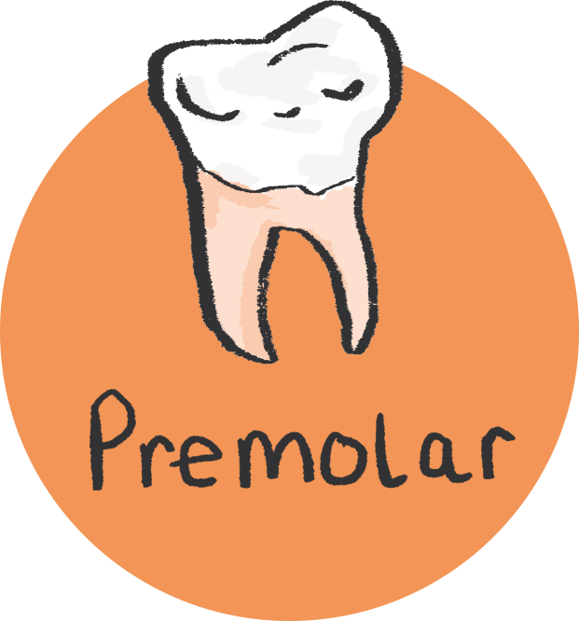
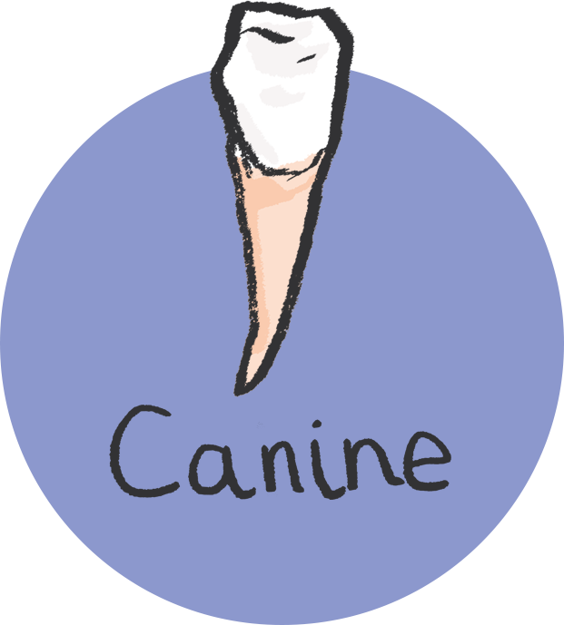
Classification activity
Compare teeth and organise into groups, by either types of teeth or different species.
You will need:
Pictures of different types of human teeth.
Notes:
Resource note:
To source pictures of different types of human teeth, the search term for this would be 'four types of teeth' this should yield appropriate images.

Slide 42
Have a careful look at your selection of teeth images.
Discuss the functions of the different types of teeth.
Sort the teeth pictures into their types.
Quick Quiz: Can you remember what they are?
Incisor
Canine
Premolar
Molar
Look carefully at the shapes of the teeth and think about the kinds of marks they make.
Notes:
Possible Extension:
You could also use images of different types of teeth from animals.
PROMPTS FOR CREATIVE THINKING:
What can animal teeth tell us about what those animals eat? What about animals that don't have any teeth at all? Start by imagining, using intuition and existing knowledge, and then checking through research.

Slide 43
Art activity
Medium: Clay / Sculpture
Explore the imprints and textures created by different types of teeth, using clay to create relief tile sculptures.

Slide 44
You will need:
Chewy sweets such as Starbursts, Fruitella, etc (few per person)
Air drying clay
Aprons
Ruler
Clay tools
Rolling pins
Table covering or boards to roll clay out on
Paper and pencil
Top tip! For those who do not like the feeling of clay on their hands, try wearing gloves when handling it!

Slide 45
Cover the table you are working on with a table covering or put down a board to work on.
With clean hands, start by carefully pressing your different teeth into the chewy sweets and see what marks they make.
Be careful not to chew and swallow them as you need to keep them for reference!
Look carefully at the different shapes and marks your teeth make.
Can you match the imprints of your teeth to the different types of teeth you’ve learned about?
Notes:
This activity can help learners connect their theoretical knowledge to their own experience and bodies.

Slide 46
continued…
Take a block of clay which is roughly the size of your fist and roll it out on the table.
Every time you roll the clay, pick it up and turn it over and roll the clay from the other direction.
Top tip: this will stop the clay sticking to the table!
Roll your tile until it is about 2cm thick all the way across.
Top tip: you can use wooden spacers to help with this.
Using a ruler cut a square that is roughly 10cm by 10cm and trim off any excess clay.
Top tip: you can put this back in the bag and use for later.

Slide 47
continued…
Look back at the images of the different types of teeth as well as your sweets. Can you remember what all of the different types of imprints of teeth are?
For example, canines might make sharp pointy lines or molars might make bumpy wobbling marks.
Using your clay and tools, create a pattern drawn into the clay made up of marks made by different types of teeth.
Alternatively you could follow the layout of teeth in a human or animal.
When carving into the clay, try not to press too deeply as it will pierce a hole in it and might crack when it dries.
Notes:
There may be a temptation here for children to want to create marks that are simply pleasing to them, but they should be encouraged to reference the marks that their teeth made and try to replicate these, although in a pattern of their choosing. This could be supported through a comparison exercise afterwards, using the chewy sweets.
It may also be useful to explain to children that each person’s teeth are unique, so they will be creating a piece of art which is unique to them.

Slide 48
continued…
When you have finished your design, leave your tile somewhere dry and warm for a few days until it is fully dried out.
After you've made your clay tile, lay the final piece onto a sheet of paper and annotate it to explain the different teeth you have represented and their functions.
Notes:
PROMPTS FOR CREATIVE THINKING:
in pairs, students could choose one pattern that the other student has created that they like, and be shown by that student how they achieved it. They can also discuss anything that they felt didn't work as well as they had hoped, and what they learnt from this - seeing this not as a failure but as an opportunity for development.

Slide 49
“Holly Hendry is one of my favourite artists, she creates sculptural artworks which often feature different body parts. See you if can spot any teeth!” Kaitlin
Barbara Hepworth was an English artist and sculptor, who took inspiration from the natural landscape. Try having a careful look at the different textures Hepworth created on the surfaces of her sculptures.
“Jacques Lipchitz was a Cubist sculptor who created some fascinating reliefs, they might give you some ideas about how to draw into your clay.” Kaitlin
Holly Hendry
Barbara Hepworth
Jacques Lipchitz

Slide 50
With Year 5
Notes:
Curriculum Links: Being able to describe the differences in the life cycles of a mammal, an amphibian, an insect and a bird
Curriculum Links: Practical scientific methods, processes and skills: recording data and results of increasing complexity using scientific diagrams and labels, classification keys, tables, scatter graphs, bar and line graphs.
Non statutory - They should use and develop keys and other information records to identify, classify and describe living things and materials, and identify patterns that might be found in the natural environment.

Slide 51
Classification activity
Describe the differences in the life cycles of a mammal, an amphibian, an insect and a bird.
You will need:
Pencil and paper
Images of TWO different animals from TWO different animal classes.
Quiz: Can you remember what the six different animal classes are?
Notes:
Please note - Prior knowledge of basic life cycle of bird/mammal/insect/amphibian required - you may wish to have the resources you used printed off for reference. A popular subscription education website has some great life cycle resources!

Slide 52
Have a careful look at images of two different animals’ lifecycles, from two different classes.
Think carefully about the similarities and differences between their life cycles.
Try drawing a Venn diagram to explore the similarities and differences you have thought about.
Top Tip: Look at an example Venn diagram on the next slide…
Write down the reasons for your decisions.

Slide 53
Frog
Chicken
Both Frog & Chicken
Eggs are fertilised after they are laid
Adults mate
Lays eggs
Recently hatched young have gills and breathe through them
Adults breathe through lungs
Recently hatched young have lungs and breathe air
Young are not directly fed by their parents
Body structure does not fundamentally change as they grow
Also breathe through moist skin
Go through metamorphosis – a change in the animal’s body structure

Slide 54
Art activity
Medium: Zine Making and Mono printing
A zine is a magazine hand-made by artists.
For this activity, have a go at making a zine inspired by the lifecycle of an animal.
Create artwork to go inside by trying a type of printmaking called 'mono-printing'.

Slide 55
You will need:
A3 paper (1 per person)
A6 paper sheets (multiple sheets per person)
Scissors
Table coverings
Aprons
Reference images of animals during different stages of their lifecycle
Acetate sheets (1 per person)
Printing rollers
Printing ink
Arts and craft tray for rolling ink out
Pencils
Glue
Notes:
Resource notes:
A6 Paper sheets - An easy way to make these is to cut A4 pieces of paper into four rectangles
Printing ink – Use block printing ink which is water based (you could substitute this for acrylic paint)
Acetate Sheets - Used for OHP projectors. These will be your printing 'plates’ You could use another flat surface to roll printing ink out on to, such as a Perspex sheet or a picture frame

Slide 56
Stage 1: How to Fold a Zine
Click here to watch Kaitlin on YouTube…

Slide 57
Take A3 piece of paper.
Fold your piece of paper in half lengthways.
Fold your piece of paper in half width ways.
Unfold the piece of paper.
Take one of the shorter sides and fold it in to meet the middle crease.
Open the piece of paper back out.
Repeat the last fold again on the other side.
Unfold your piece of paper so that it is flat. You should be able to see eight boxes.
Turn the paper over.
Push the shorter ends of the piece of paper towards each other. This will lift the central fold upright.
Cut along the side where the crease is. Be sure to only cut half-way down the piece of paper.
Open your zine up by bringing the corners on the long sides together.
This should create a booklet shape.
Then fold each one of the pages down to create a folded zine.
Stage 1: How to Fold a Zine – the steps…

Slide 58
To create the artwork in your zine we are going to try
positive
monoprinting
It’s a really easy
printmaking
process!
Stage 2 - Design the Artwork for Your Zine
You are going to be making a different monoprint for each stage of the lifecycle of your chosen animal.
You’ll be printing these on smaller pieces of paper.
When they are dry, you will cut these prints up and stick them in your zine so make sure they are the right size!
But first:
Choose an animal lifecycle you would like to focus on.
Research the different stages of its life.
With a pencil, lightly sketch each stage on a different page in your zine.
Notes:
Drawing the lifecycle can develop children’s observation and recording skills, and help them to notice the ways in which the animal changes.
Children can be encouraged to try to notice the details of the animal. This can also lead to other science conversations about the physical attributes of animals – about camouflage, means of locomotion (do they hop, walk, fly or undulate?), and more.

Slide 59
Stage 3 - How to Monoprint
Cover the table you are printing on with newspaper or an old tablecloth, to protect it from stains.
Put a small blob of ink (the size of a 1p coin) on your printing tray and roll out the ink.
Top Tip - When you hear a sticky sound, you know the ink is evenly applied to the roller!
Take a sheet of acetate and either tape or hold down on the table.
Notes:
Notes to teacher: Try to get the children to create monoprints which are roughly the size of a postcard or A6 piece of paper, in order to fit on the different pages of the zine booklet.

Slide 60
Stage 3 - How to Monoprint
Roll the ink out on the acetate for a minute in different directions to make sure the ink is evenly distributed.
Very gently place the piece of paper on top of the acetate with the ink on.
Using a pencil, draw your design on the back of the paper, being careful not to press with your hand on the paper.
When you are done, gently peel the paper off to reveal your print!
Notes:
PROMPTS FOR CREATIVE THINKING
Before they create their print, students might like to look at examples – there are some examples of print artists on the last slide of this section. Do any of these inspire them? What it is about these designs that they like? How do they think the artist might have made these? Can they check this through research?
Students can reflect on the outcome of their print - is there anything they would do differently next time? More / less ink, different pencil pressure, a more simple / more complex design? They can try this when creating the print for the next stage.

Slide 61
Stage 3 - How to Monoprint
To make another print, either re-roll the ink to go again or wash the acetate off and add a new colour.
Try experimenting with different pressures for different thicknesses in your lines.
Once your prints are fully dry, cut them up and stick them into the different pages of your zine.
Add a title page to your zine and annotations (explanatory notes) which explain the lifecycle stages of your animal.
Notes:
Possible Extension:
When making their lifecycle zine, you could get children to include a page comparing the chosen animal class with another (maybe even including their Venn diagram).

Slide 62
Sangeeta Gupta
“Look at Sangeeta's abstract prints. Look at ways of creating backgrounds for prints'' Gill
“For detail in drawings into ink. Create layered monoprints using the two techniques - perhaps using some of the animals and fossils studied in the science investigations'' Gill
“I have always really loved Gabo's monoprint series, and how he draws so carefully directly into the ink'' Kaitlin
Georgina Brown
Naum Gabo

Slide 63
Evolution: Fossils
With Year 6
Notes:
Curriculum Links: Recognise that living things have changed over time and that fossils provide information about living things that inhabited the Earth millions of years ago
Curriculum Links: Practical scientific methods, processes and skills: recording data and results of increasing complexity using scientific diagrams and labels, classification keys, tables, scatter graphs, bar and line graphs.
Non statutory - They should use and develop keys and other information records to identify, classify and describe living things and materials, and identify patterns that might be found in the natural environment.

Slide 64
Classification activity
Sort and classify a selection of animal skeletons from the different stages of their evolution.
You will need:
A selection of reference images which provide evidence for evolution: Top tip: a Google search will show some great images of flat fish, ferns and horses for example
Notes:
Resources note:
We suggest the following search terms: horse fossil record, whale fossil record, flat fish fossil record, fern fossil record.

Slide 65
Imagine you are an Evolution Detective!
Start by looking carefully at the selection of images you have.
Try to sort sets of pictures into chronological order.
What similarities and differences do you notice?
What can you conclude about how the organism has changed?
Does this provide evidence for evolution?
Notes:
PROMPTS FOR CREATIVE THINKING
Encourage students to consider different possibilities and make their own judgements and connections in order to order the images and draw conclusions about the way that the organism has changed over time. They can use their own knowledge of what the organism looks like today to inform this process.
Students can refer to reference materials to check their answers - were their assumptions correct? Was there anything that surprised them?

Slide 66
Art activity
Medium: Block Printing
You will need:
Long rolls of paper (wallpaper backing or lining paper)
Masking tape (to secure paper)
A4 paper for test prints
Scissors
Block printing water based ink
Art and craft tray
Printing rollers
Pencil
Cardboard
Sticky-back foam sheets

Slide 67
Choose a species to research and find out about the stages of its evolution.
You could sketch these out or print pictures from a computer.
To create the artwork for your prints, we are going to have a go at a type of printmaking called 'block printing’.
To create the 'Evolution Wallpaper' artwork you're going to make some printing stamps for the block printing, one for each stage of your species evolution.

Slide 68
Firstly, using your pencil, draw out your design for your printing stamp on the foam. Press firmly into the foam with the pencil when creating any detail to ensure the lines come out clearly in the print.
Cut out your stamp design.
Attach it to the piece of cardboard by peeling off the backing paper and sticking it down.
Trim the edges of the cardboard around your design, so that there is a centimetre of cardboard around the design. This will make it easier to hold when you're printing.
Notes:
PROMPTS FOR CREATIVE THINKING
Are there any examples of wallpaper / printing that inspire them? There are some examples of artists in the final slide of this section. What is it about these designs that they like? How do they think the artist might have made these? Are there any reference sources they can use to check their assumptions?

Slide 69
Cut a strip from the roll of paper and secure it on the table with masking tape.
Squeeze a small blob of printing ink out on your tray. Roll the ink out using your roller.
Top Tip: when you hear a sticky sound, you know the ink is evenly applied to the roller!
Roll out the ink on the foam side of the stamp, being careful not to get any ink on the cardboard.
Press the stamp onto your paper, applying even pressure (you can do this by hand or with a dry roller).
Top Tip: Try to be careful not to move it so that it doesn't smudge.
Peel off your stamp to reveal your print!
Build up your design by printing the different stages of the evolution of your species across the paper.
Notes:
PROMPTS FOR CREATIVE THINKING
Students can reflect on the outcome of their print - is there anything they would do differently next time? More / less ink, different pencil pressure, a more simple / more complex design? They can try this when creating the print for the next stage.
Possible Extension:
Work with your class to 'curate' or organise an exhibition, you could classify artworks by the category (e.g mammal, amphibians, reptiles, birds or plants) or by different artistic styles or approaches.'

Slide 70
“Have a go at examining how Morris used nature in his wallpaper designs. You could make links to maths and symmetry by taking images of your own prints and use ICT to create symmetrical patterns e.g. by flipping and rotating the photographs.” Gill
‘Snake in the Grass, Alas', Linocut
“John Banting was a British artist and writer. I really like his linocut print ‘ Snake in the Grass, Alas 1931’ because of the bold lines and ombre fade of the bright colours in the print. Just like block printing, linocuts are another form of relief printing, and is easy to have a go at.” Kaitlin
Althea McNish was a textile designer, originally from Trinidad, who used printing techniques to create bold, colourful and eye-catching designs. She often created repeating patterns which were inspired by plants.
William Morris
John Banting
Althea McNish

Slide 71
Authors:
Kaitlin Ferguson, Artist
Gill Sekatawa, Art and Design Lead, Nelson Academy
Sarah Melia, Science Lead, Nelson Academy
Illustrator:
Sophie Clouston, Creative Arts East
Commissioned and produced in 2021 by:
Barbican Creative Learning
Creative Arts East for PEACH West Norfolk
With thanks to:
Staff and students at Nelson Academy, Downham Market
Norfolk and Norwich Festival Bridge
Attribution:
You are welcome to share this resource with colleagues and adapt it as you see fit. Please note that if you do so, the following credit line must be used:
Taken from Teacher Lab: Teaching Primary Science through Creativity, written by Kaitlin Ferguson, Gill Sekatawa and Sarah Melia. Illustrations by Sophie Clouston. Commissioned by Barbican Creative Learning and Creative Arts East. With support from the Esmée Fairbairn Foundation and Nelson Academy, Downham Market. Teacher Lab is a Barbican Creative Learning programme

Slide 72
Below are some links to more resources for supporting creativity in learners:
https://www.researchgate.net/publication/305218451_A_Five_Dimensional_Model_of_Creativity_and_its_Assessment_in_Schools
https://www.thomastallisschool.com/tallis-habits.html
https://nnfestival.org.uk/festival-bridge/schools-education/resource-bank/
https://www.groundworkgallery.com/exhibitions-about-environment/virtual-tour/

